Slide 1
COPD Medical Training
Medical Affairs Team
For internal use only
Date of preparation: May 2025
Content Lab Code:NP-EG-CPU-PPT-250003

Slide 2
Disclaimer
These slides are for internal training only.
These slides are not for onward distribution outside GSK.
These slides are not to be used for any external promotional purposes.

Slide 3
Learning objectives
This module should enable you to
Define COPD and its characteristic features
Describe the common symptoms of COPD and their impact on patients
Discuss exacerbations in COPD and their impact on patients
Understand the GOLD 2025 COPD strategy document
Provide an overview of the recommendations in the GOLD 2023 COPD strategy document
GOLD, Global Initiative for Chronic Obstructive Lung Disease.
FOR INTERNAL GSK USE ONLY

Slide 4
What is COPD?
FOR INTERNAL GSK USE ONLY

Slide 5
What is COPD?
GOLD 2025 definition
‘Chronic Obstructive Pulmonary Disease (COPD) is a heterogenous lung condition characterized by chronic respiratory symptoms (dyspnea, cough, sputum production, exacerbations) due to abnormalities of the airways (bronchitis, bronchiolitis) and/or alveoli (emphysema) that cause persistent, often progressive, airflow obstruction’.
GOLD, Global Initiative for Chronic Obstructive Lung Disease.
Global Initiative for Chronic Obstructive Lung Disease. Global Strategy for the Diagnosis, Management, and Prevention of Chronic Obstructive Pulmonary Disease (2025 Report). https://goldcopd.org/wp-content/uploads/2024/11/GOLD-2025-Report-v1.0-15Nov2024_WMV.pdf. Accessed November 21, 2024.
FOR INTERNAL GSK USE ONLY

Slide 6


COPD is a complex, multicomponent, heterogeneous disease¹
COPD is a multicomponent disease characterised by chronic obstruction of lung airflow.¹
COPD is a progressive disease that usually worsens over time.²
The clinical, functional and radiological presentation of COPD varies greatly from patient to patient despite having a similar degree of airflow limitation.¹
COPD encompasses a group of disorders characterised by the presence of incompletely reversible airflow obstruction with overlapping symptoms from different disease entities, including³
Chronic bronchitis
Emphysema.
Systemic component
Mucociliary dysfunction
Classical representation of disease progression^{1,2,4}
Airway inflammation
Symptoms
Exacerbation (or ‘flare-ups’)
Declining health status
Death
Airflow limitation
Structural changes
1. Agusti AG. Respir Med. 2005;99(6):670-682; 2. Wedzicha JA, et al. Respir Care. 2003;48(12):1204-1213; 3. Marsh SE, et al. Thorax. 2008;63(9):761-767; 4. Hogg JC, et al. N Engl J Med. 2004;350(26):2645-2653.
FOR INTERNAL GSK USE ONLY

Slide 7
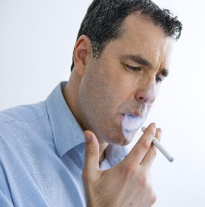
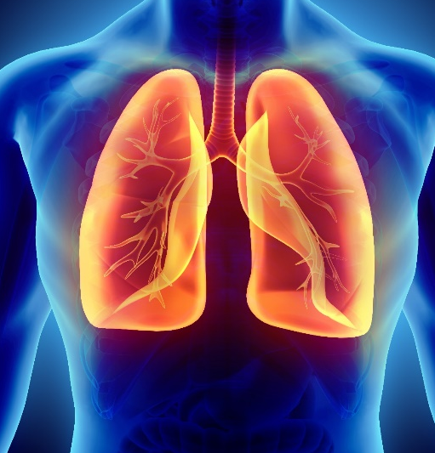
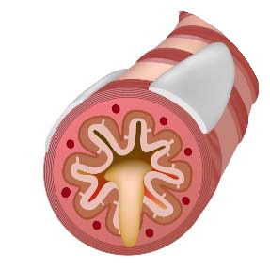



COPD is a complex, multicomponent, heterogeneous disease
COPD results from gene-environment interactions occurring over time that may damage the lungs or alter normal development.
Patients with COPD typically experience dyspnoea, activity limitation and/or cough with or without sputum production.
Patients can also experience acute episodes of increased respiratory symptoms termed exacerbations that can influence their prognosis and may require additional therapy.
Patients may harbour other comorbid diseases that could influence treatment/prognosis and may require specific treatment.
Dyspnoea
Exacerbation
Coughing
GOLD. Global Strategy for the Diagnosis, Management, and Prevention of Chronic Obstructive Pulmonary Disease (2023 Report). https://goldcopd.org/2023-gold-report-2/. Accessed February 20, 2023.
FOR INTERNAL GSK USE ONLY

Slide 8
Common symptoms of COPD
FOR INTERNAL GSK USE ONLY

Slide 9


Common symptoms of COPD
Chronic dyspnoea is one of the most characteristic symptoms of COPD, and cough with sputum production is present in up to 30% of patients.
Airflow limitation may be present without chronic dyspnoea and/or cough and sputum production and vice versa.
Symptoms may vary from day to day and may precede the development of airflow limitation.
Dyspnoea
Sputum production
Cough
Wheezing and chest tightness
GOLD. Global Strategy for the Diagnosis, Management, and Prevention of Chronic Obstructive Pulmonary Disease (2023 Report). https://goldcopd.org/2023-gold-report-2/. Accessed February 20, 2023.
FOR INTERNAL GSK USE ONLY

Slide 10
Dyspnoea: A cardinal symptom of COPD
Dyspnoea is a cardinal symptom of COPD and a major cause of disability and anxiety.¹
In a study of 2441 patients with COPD across 17 European countries, dyspnoea was the most frequent symptom experienced by patients (72.5%).²
Dyspnoea significantly contributes to disease burden and poor quality of life.^{3,4}
I am afraid to stay at home alone⁵
I postpone everything to prevent gasping for breath. Housework, cooking, going out...⁶
96% of pulmonologists recommend pulmonary rehabilitation in an online questionnaire on dyspnoea management conducted in France⁷
46% of pulmonologists were willing to prescribe benzodiazepines for hospitalised patients⁷
1. Miravitlles M, et al. Respir Res. 2014;15(1):122; 2. Kessler R, et al. Eur Respir J. 2011;37(2):264-272; 3. Booth S, et al. Expert Rev Respir Med. 2009;3(1):21-36; 4. Burgel PR, et al. Respir Med. 2013;107(2):233-241; 5. Wong SSL, et al. BMC Fam Pract. 2014;15:67; 6. Avşar G, et al. Aust J Adv Nurs. 2011;28(2):46-52; 7. Carette H, et al. BMC Pulm Med. 2019;19(1):95.
FOR INTERNAL GSK USE ONLY

Slide 11
Dyspnoea leads to declining functional status^{1,2}
100
Dyspnoea interferes with daily activities³
Proportion of patients affected (%)
90
Dyspnoea with activities
80
70
Patient becomes more sedentary to avoid dyspnoea‑producing activities
(decreases activity)
60
50
40
Decline in dyspnoea¹
Deconditioning aggravates dyspnoea: patient adjusts
by reducing
activity further
30
20
10
0
Sports/ hobbies
Going shopping
Heavy household chores
Going up/ down stairs
Daily activities affected by COPD symptoms
GSK created figure from Kessler R, et al. 2011; GSK created figure from Reardon JZ, et al. 2006.
1. Reardon JZ, et al. Am J Med. 2006;119(10 suppl 1):32-37; 2. GOLD. Global Strategy for the Diagnosis, Management, and Prevention of Chronic Obstructive Pulmonary Disease (2023 Report). https://goldcopd.org/2023-gold-report-2/. Accessed February 20, 2023; 3. Kessler R, et al. Eur Respir J. 2011;37(2):264-272.
FOR INTERNAL GSK USE ONLY

Slide 12
Chronic cough: First symptom of COPD
Chronic cough is often the first symptom of COPD and is frequently disregarded by the patient as a consequence of smoking or environmental pollution.
Initially, cough may be intermittent but can often persist throughout the day.
Chronic cough may or may not hamper productivity.
In some cases, significant air flow limitation may develop without the presence of cough.
GOLD. Global Strategy for the Diagnosis, Management, and Prevention of Chronic Obstructive Pulmonary Disease (2023 Report). https://goldcopd.org/2023-gold-report-2/. Accessed February 20, 2023.
FOR INTERNAL GSK USE ONLY

Slide 13

Sputum production: Common symptom in COPD
Patients with COPD commonly produce small quantities of tenacious sputum with coughing.¹
Sputum production is often difficult to evaluate because patients may swallow rather than expectorate it.¹
Sputum production could be intermittent, with periods of flare-up interspersed with periods of remission.²
A large volume of sputum production may be associated with underlying bronchiectasis.¹
1. GOLD. Global Strategy for the Diagnosis, Management, and Prevention of Chronic Obstructive Pulmonary Disease (2023 Report). https://goldcopd.org/2023-gold-report-2/. Accessed February 20, 2023; 2. Allinson JP, et al. Am J Respir Crit Care Med. 2016;193(6):662-672.
FOR INTERNAL GSK USE ONLY

Slide 14
Wheezing and chest tightness: Common symptom in COPD
May vary between days and over the course of a single day.
Chest tightness often follows exertion, is poorly localised and may arise from isometric contraction of intercostal muscles.
The absence of wheezing or chest tightness does not exclude diagnosis of COPD.
GOLD. Global Strategy for the Diagnosis, Management, and Prevention of Chronic Obstructive Pulmonary Disease (2023 Report). https://goldcopd.org/2023-gold-report-2/. Accessed February 20, 2023.
FOR INTERNAL GSK USE ONLY

Slide 15
Exacerbations: A key component of COPD
FOR INTERNAL GSK USE ONLY

Slide 16
What is an exacerbation of COPD?
Revised GOLD 2025 definition
‘An exacerbation of Chronic Obstructive Pulmonary Disease (COPD) is an event characterized by increase dyspnea and/or cough and sputum that worsens in < 14 days which may be accompanied by tachypnea and/or tachycardia and is often associated with increased local and systemic inflammation caused by infection, pollution, or other insult to the airways’.
GOLD, Global Initiative for Chronic Obstructive Lung Disease.
Global Initiative for Chronic Obstructive Lung Disease. Global Strategy for the Diagnosis, Management, and Prevention of Chronic Obstructive Pulmonary Disease (2025 Report). https://goldcopd.org/wp-content/uploads/2024/11/GOLD-2025-Report-v1.0-15Nov2024_WMV.pdf. Accessed November 21, 2024.
FOR INTERNAL GSK USE ONLY

Slide 17
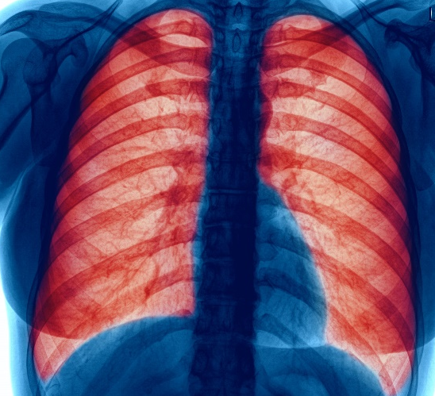
Exacerbations are important events in the management of COPD
Exacerbation: An acute worsening of respiratory symptoms that results in additional therapy
Exacerbations of respiratory symptoms can be triggered by factors (alone or in combination) such as bacterial/viral infections and environmental pollutants.
Exacerbations of COPD are important events in the management of COPD because they negatively impact health status and increase the chance of hospitalisation and disease progression.
COPD exacerbations are complex events usually associated with increased airway inflammation, increased mucous production and marked gas trapping.
Till now, grading of severity of an exacerbation has been based on the use of healthcare resources; however, this leads to variability in exacerbation outcomes due to differences in local resources and criteria for hospital visits
Notably, as per GOLD 2025, exacerbations are classified as mild, moderate, or severe based on clinically measurable thresholds.
SABD, short-acting bronchodilator.
GOLD. Global Strategy for the Diagnosis, Management, and Prevention of Chronic Obstructive Pulmonary Disease (2023 Report). https://goldcopd.org/2023-gold-report-2/. Accessed February 20, 2023.
FOR INTERNAL GSK USE ONLY

Slide 18

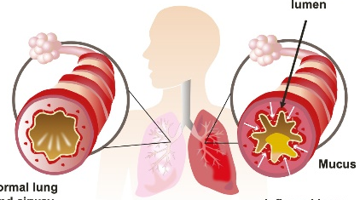


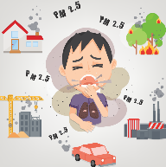
The cause of COPD exacerbations is heterogeneous^{1,2}
TRIGGERS
EFFECTS
Systemic inflammation
Increased inflammation
Viruses
Narrowed lumen
Dynamic hyperinflation
Exacerbations: increased severity of symptoms
Inflamed COPD airway
Bacteria
Mucus
Normal lung and airway
Inflamed lung and airway
Bronchoconstriction, oedema, mucus
Pollutants
Dynamic hyperinflation:³
Viral and bacterial infections are the most common triggers¹
Different triggers can cause different types of inflammation²
Results from air being trapped within the lungs after each breath
Is caused by a disequilibrium between the volume inhaled and exhaled
Occurs when patients commence inhalation before achieving full exhalation
Breathing in hyperinflated patients increases the demand on respiratory muscles.
GSK created image from Wedzicha JA, et al. 2007.
1. Wedzicha JA, et al. Lancet. 2007;370(9589):786-796; 2. Bafadhel M, et al. Am J Respir Crit Care Med. 2011;184(6):662-671; 3. Ferguson GT. Proc Am Thorac Soc. 2006;3(2):176-179.
FOR INTERNAL GSK USE ONLY

Slide 19
Exacerbations are more likely to occur as COPD progresses
Many patients with COPD experience exacerbations¹
Clinicians’ estimate of proportion of patients with COPD with an exacerbation in the last 12 months*^{,2}
Severity of COPD (predicted FEV₁)
Mild
11%
17%
Moderate
26%
29%
Severe
45%
46%
Very severe
57%
55%
0%
10%
20%
30%
40%
50%
60%
Respiratory specialist
General physician
*Global survey of 1400 clinicians from 14 countries; GSK created image from Barnes N. 2014. FEV₁, forced expiratory volume in 1 second.
1. Barnes N, et al. BMC Pulm Med. 2013;13:1-11; 2. Barnes N. Curr Med Res Opin. 2014;30(4):667-684.
FOR INTERNAL GSK USE ONLY

Slide 20


Impact of exacerbations in COPD
↑ Inflammation
↑ Mortality
↑ Likelihood of hospitalisation
Patients with frequent exacerbations
↑ Disease progression
↑ Future risk of exacerbations
↓ Quality of life
COPD exacerbations adversely impact morbidity, healthcare costs and mortality
GSK created image from Qureshi H, et al. 2014.
Qureshi H, et al. Ther Adv Chronic Dis. 2014;5(5):212-227.
FOR INTERNAL GSK USE ONLY

Slide 21
Introduction to the GOLD report
FOR INTERNAL GSK USE ONLY

Slide 22


The GOLD report
The GOLD report is revised annually and has been used as a tool by HCPs to implement effective management programmes based on local healthcare systems
GOLD works with HCPs and public health officials to
Raise awareness of the burden of COPD
Develop programmes for early detection, prevention and approaches to management.
The GOLD scientific committee was established in 2002 to review published literature on COPD management and prevention and evaluate the impact of this research on recommendations in the GOLD document.
Its members are recognised leaders in COPD research and clinical practice.
The GOLD strategy is consistent with GSK’s COPD strategy and commitment to helping physicians, provide the right patient with the right treatment
GOLD, Global Initiative for Chronic Obstructive Lung Disease; HCP, healthcare professional.
Global Initiative for Chronic Obstructive Lung Disease. Global Strategy for the Diagnosis, Management, and Prevention of Chronic Obstructive Pulmonary Disease (2025 Report). https://goldcopd.org/wp-content/uploads/2024/11/GOLD-2025-Report-v1.0-15Nov2024_WMV.pdf. Accessed November 21, 2024.
FOR INTERNAL GSK USE ONLY

Slide 23
Evolution of the GOLD strategy document
Individualised treatment for each patient
Prior to 2011
GOLD 2011 update
GOLD 2017 update
GOLD 2021 update
GOLD 2023 update
Simple spirometric grading system
Multimodal ‘ABCD’ª assessment: a combination of spirometric grades, future exacerbation risk and severity of symptoms
Refinement of the ‘ABCD’ assessment tool: criteria now based on patient symptoms and exacerbation history
Refinement of the ‘ABCD’ assessment tool: criteria now based on spirometry,
patient symptoms and
exacerbation history
Revision of the ‘ABCD’ assessment tool to the ‘ABE’^{b} assessment tool: criteria now independent of the level of patient symptoms
The GOLD 2011 strategy document established the ‘ABCD’ assessment tool, based on patient spirometric grades, future exacerbation risk and severity of symptoms.
The GOLD 2017 update to the strategy document determined that the ‘ABCD’ groups will be derived from patient symptoms (mMRC/CAT score) and their exacerbation history.
The GOLD 2021 update to the strategy document determined that the ‘ABCD’ groups will be derived from patient spirometric analysis, patient symptoms (mMRC/CAT score) and their exacerbation history.
The GOLD 2023 update to the strategy document determined that the ‘ABCD’ assessment tool will be revised to the ‘ABE’ assessment tool to recognise the clinical relevance of exacerbations, independent of the level of patient symptoms.
Spirometry remains key in diagnosis, prognosis and determining treatment with other therapeutic approaches.
ªABCD, A – few symptoms, better lung function; B – more symptoms, better lung function; C – few symptoms, poor lung function; D – more symptoms, poor lung function; ^{b}ABE, A – bronchodilator; B – LABA + LAMA; E – LABA + LAMA and/or ICS.
CAT, Chronic Obstructive Pulmonary Disease Assessment Test; GOLD, Global Initiative for Chronic Obstructive Lung Disease; ICS, inhaled corticosteroid; LABA, long-acting beta agonist; LAMA, long-acting muscarinic antagonist; mMRC, modified British Medical Research Council.
GOLD. Global Strategy for the Diagnosis, Management, and Prevention of Chronic Obstructive Pulmonary Disease (2023 Report). https://goldcopd.org/2023-gold-report-2/. Accessed February 20, 2023.
FOR INTERNAL GSK USE ONLY

Slide 24
Recommendations in the GOLD 2025 strategy document
FOR INTERNAL GSK USE ONLY

Slide 25
GOLD 2025 strategy document
Overview of recommendations
GOLD 2025 strategy document
Diagnosis of COPD
Assessment of COPD
Pharmacological and non-pharmacological management of COPD
Monitoring of COPD
COPD should be considered in any patient who has dyspnoea, chronic cough or sputum production, a history of recurrent lower respiratory tract infections and/or a history of exposure to risk factors for the disease.
Forced spirometry showing the presence of post-bronchodilator FEV₁/FVC < 0.7 is mandatory to establish a COPD diagnosis.
Additional clinical assessment such as lung volume measurement, diffusion capacity and exercise training may be done in patients with persistent symptoms after initial treatment.
The goals of COPD assessment are to determine the
Severity of airflow obstruction
Impact of disease on the patient’s health status
Risk of future events such as hospitalisations, exacerbations or death.
Validated and comprehensive questionnaires can be used to carry out a formal assessment of symptoms.
Initial pharmacotherapy should be based on the patients’ GOLD group (ABE); patients should be offered guidance on self‐management and should be provided with a written action plan.
An individualised approach to COPD treatment based on level of symptoms and exacerbations is recommended.
HCPs should use complementary pharmacological and non‐pharmacological approaches as a part of the comprehensive management plan.
Routine follow-up is essential to modify management as lung function may worsen over time and to identify complications or comorbidities.
To adjust pharmacotherapy appropriately, the current regimen should be discussed with the patient during each follow-up visit.
Factors discussed should include dosage of prescribed medications, smoking status, adherence to the regimen, effectiveness, inhaler technique and side effects.
FEV₁, forced expiratory volume in 1 second; FVC, forced vital capacity; GOLD, Global Initiative for Chronic Obstructive Lung Disease; HCP, healthcare professional.
Global Initiative for Chronic Obstructive Lung Disease. Global Strategy for the Diagnosis, Management, and Prevention of Chronic Obstructive Pulmonary Disease (2025 Report). https://goldcopd.org/wp-content/uploads/2024/11/GOLD-2025-Report-v1.0-15Nov2024_WMV.pdf. Accessed November 21, 2024.
FOR INTERNAL GSK USE ONLY

Slide 26
Summary
COPD is a heterogenous lung condition characterised by chronic respiratory symptoms due to abnormalities of the airway.
Patients with COPD typically experience dyspnoea, activity limitation and/or cough with or without sputum production.
Patients can also experience acute episodes of increased respiratory symptoms called exacerbations that can influence their prognosis and may require additional therapy.
The GOLD 2025 strategy document updates.
GOLD, Global Initiative for Chronic Obstructive Lung Disease.
GOLD. Global Strategy for the Diagnosis, Management, and Prevention of Chronic Obstructive Pulmonary Disease (2023 Report). https://goldcopd.org/2023-gold-report-2/. Accessed February 20, 2023.
FOR INTERNAL GSK USE ONLY

Slide 27
COPD epidemiology and burden

Slide 28


COPD affects over 380 million people worldwide¹
In 2012, > 3 million people died of COPD, which accounts for 6% of all global deaths.²
COPD is a major cause of chronic morbidity and mortality throughout the world.² Reported prevalence rates vary considerably between countries because of different survey methods, population studies, diagnostic criteria and year of study.^{3,4}
Evidence suggests that 1 in 4 people will develop COPD during their lifetime.⁵
COPD is predicted to become the third leading cause of death by 2030 worldwide and caused 3.23 million deaths in 2019.^{5,6}
The prevalence of COPD²
Risk increases with age due to continued exposure to COPD risk factors; it primarily affects people aged ≥ 40 years
Is higher in smokers and ex-smokers vs non-smokers
The prevalence of COPD is predicted to increase due to a combination of continued exposure to COPD risk factors and world’s population ageing.²
1. Adeloye D, et al. J Glob Health. 2015;5(2):1-17; 2. GOLD. Global Strategy for the Diagnosis, Management, and Prevention of Chronic Obstructive Pulmonary Disease (2023 Report). https://goldcopd.org/2023-gold-report-2/. Accessed February 2023; 3. Rycroft CE, et al. Int J Chron Obstruct Pulmon Dis. 2012;7:457-494; 4. Buist AS, et al. Lancet. 2007;370(9589):741-750; 5. Gershon A, et al. Lancet. 2011;378(9795):991-996; 6. WHO 2022. Chronic Obstructive Pulmonary Disease (COPD). https://www.who.int/news-room/fact-sheets/detail/chronic-obstructive-pulmonary-disease-(copd). Accessed March 2023.

Slide 29




COPD prevalence is increased by a number of factors
Smoking
There is a strong positive association between cigarette smoking and COPD, with higher prevalence in heavy smokers.¹
Biomass exposure
Biomass fuel (particularly wood smoke) exposure increases the chances of developing COPD.^{2,3}
Age
The prevalence of COPD in patients aged ≥ 40 years increases steeply; the highest prevalence is among those aged > 60 years.^{1,4,5}
Gender
In smoking populations, prevalence is higher in men than in women; however, in non-smoking populations, it is frequently higher in women.^{1,4,5}
Airway hyper-responsiveness
Airway hyper-responsiveness accounts for 15% of attributable risk and leads to reduction in FEV₁.⁵
Air pollution
Air pollution is associated with increased respiratory symptoms and hospital admissions in patients with COPD.⁶
Genetics
Severe hereditary deficiency of the protective enzyme inhibitor AATD is known as a genetic risk factor for COPD; however, other genetic risk factors have also been identified.⁵
AATD, alpha-1 antitrypsin deficiency; FEV₁, forced expiratory volume in 1 second.
1. Buist AS, et al. Lancet. 2007;370(9589):741-750; 2. Kurmi OP, et al. Thorax. 2010. 65(3):221-228; 3. Po JYT, et al. Thorax. 2011;66(3):232-239; 4. Lamprecht B, et al. Chest. 2011;139(4):752-763; 5. GOLD. Global Strategy for the Diagnosis, Management, and Prevention of Chronic Obstructive Pulmonary Disease (2023 Report). https://goldcopd.org/2023-gold-report-2/. Accessed February 2023; 6. MacNee W;Clinical Respiratory Medicine;2012;4;531-552.

Slide 30

COPD is a leading cause of morbidity and mortality
~ 5.4 million annual deaths from COPD and related conditions by 2060¹
In 2018, COPD was the fourth leading cause of death in the US²
Under-recognition and underdiagnosis of COPD reduces the accuracy of COPD mortality data¹
Although COPD databases for morbidity outcome measures are less readily available and usually less reliable than mortality databases, data indicate that morbidity due to COPD increases with age¹
Morbidity from COPD may be affected by other concomitant chronic conditions that are related to smoking, ageing and COPD¹
1. GOLD. Global Strategy for the Diagnosis, Management, and Prevention of Chronic Obstructive Pulmonary Disease (2023 Report). https://goldcopd.org/2023-gold-report-2/. Accessed February 2023; 2. CDC. Basics About COPD. https://www.cdc.gov/copd/basics-about.html. Accessed February 2023.

Slide 31
One major cause of COPD morbidity is exacerbations
Exacerbations of COPD* represent a major burden for patients, society and caregivers^{1,2}
> 50%
of patients with COPD experience exacerbations²
7%–33%
of patients with COPD are hospitalised per year as a result of an exacerbation³
50%
of patients die within 3.6 years of their first hospitalisation for a COPD exacerbation²
*An exacerbation is an event characterised by increased dyspnoea and/or cough and sputum that worsens in < 14 days, which may be accompanied by tachypnoea and/or tachycardia and is often associated with increased local and systemic inflammation caused by infection, pollution or other affliction to the airways.¹
1. GOLD. Global Strategy for the Diagnosis, Management, and Prevention of Chronic Obstructive Pulmonary Disease (2023 Report). https://goldcopd.org/2023-gold-report-2/. Accessed February 2023; 2. Hurst JR, et al. Eur J Int Med. 2020;73:1-6; 3. Hurst JR, et al. N Engl J Med. 2010;363(12):1128-1138.

Slide 32
Comorbidities are common in COPD and have a major impact on clinical outcomes¹
Many patients with COPD present with significant comorbidities such as cardiovascular disease, musculoskeletal impairment and diabetes mellitus^{1,2}
Some comorbidities occur more frequently than others:²
GSK created figure, Kahnert et al, 2018. 1. GOLD. Global Strategy for the Diagnosis, Management, and Prevention of Chronic Obstructive Pulmonary Disease (2023 Report). https://goldcopd.org/2023-gold-report-2/. Accessed February 2023; 2. Kahnert K;Respiratory Medicine;2018;134;79-85.

Slide 33

The frequency of comorbidities depends on the severity of COPD and age
Although comorbidities are common at any severity of COPD¹, the frequency of comorbidities typically increases with severity and patient age²
Cardiovascular disease
Cardiovascular disease is a major cause of death upon hospitalisation for a COPD exacerbation.¹
Lung cancer
The risk of developing lung cancer increases with age and with increased airflow limitation, which is associated with COPD severity.²
Diabetes mellitus
The risk of developing type 2 diabetes mellitus increases with age and can increase with COPD progression.³
Osteoporosis
Prevalence of osteoporosis increases with age; risk of vitamin D deficiency and vertebral fractures increases with COPD severity.²
Mood disorders
Many patients with COPD experience anxiety and/or depression, with the likelihood of mood disorders increasing as COPD progresses.^{1,4}
Sleep disorders
The prevalence of sleep disorders increases with age and COPD severity.⁵
GSK created figure, Kahnert et al, 2018. 1. GOLD. Global Strategy for the Diagnosis, Management, and Prevention of Chronic Obstructive Pulmonary Disease (2023 Report). https://goldcopd.org/2023-gold-report-2/. Accessed February 2023; 2. Chatila WM;Proceedings of The American Thoracic Society;2008;5;549–555; 3. Rogliani P;COPD Research and Practice;2015;1;1-9; 4. van Manen JG;Thorax;2002; 57;412–416; 5. Prinz P;The New England Journal of Medicine;1990;323;520-526.

Slide 34
The burden of COPD on patients and caregivers

Slide 35
COPD is underdiagnosed and undermanaged
COPD is underdiagnosed because…
It is difficult to differentiate COPD from other respiratory diseases since it manifests with common respiratory symptoms such as dyspnoea,* cough and/or increased production of sputum¹
Patients frequently neglect their COPD symptoms:¹
Patients may consider cough and the production of sputum as ‘normal’ when smoking
They may also attribute dyspnoea solely to age and reduced physical fitness
Therefore, many patients present to physicians when their COPD has already led to a significant reduction in lung function
Poor access to spirometry and lack of expertise across regions are major contributors in COPD underdiagnosis³
Once diagnosed, a significant proportion of patients with COPD are
undermanaged.^{1,2} This results in substantial onward healthcare costs^{1,2}
*Dyspnoea is a cardinal symptom of COPD, otherwise known as breathlessness.
1. GOLD. Global Strategy for the Diagnosis, Management, and Prevention of Chronic Obstructive Pulmonary Disease (2023 Report). https://goldcopd.org/2023-gold-report-2/. Accessed February 2023; 2. MacNee W;Clinical Respiratory Medicine;2012;4;531-552; 3. Diab N;American Journal of Respiratory and Critical Care Medicine;2018;198;1130-1139.

Slide 36
As COPD progresses, patient burden increases
Physical symptoms
Undermanagement and progression of COPD increases patient burden
Physical
Increased COPD severity is associated with reduced HRQoL and impaired ability to complete everyday activities⁴
Up to 74% of patients report that COPD limits their ability to walk⁴
As COPD progresses, there is a decrease in lung function, resulting in interference with activities of daily living.^{1,3}
COPD affects the airways and lung parenchyma.^{1,3}
Patients with COPD often find that physical activity becomes increasingly difficult as their COPD progresses: this can lead to sarcopenia (loss of skeletal muscle mass) and increases the risk of diabetes, osteoporosis and cardiovascular disease.^{1,2}
People with COPD can die prematurely.²
COPD has a significant impact on patients’ daily lives…
Many patients with COPD report that COPD affects their quality of sleep^{4–6}
~40% of patients with severe COPD say that their symptoms make activities such as washing and dressing difficult⁵
HRQoL, health-related quality of life.
1. MacNee W;Clinical Respiratory Medicine;2012;4;531-552; 2. GOLD. Global Strategy for the Diagnosis, Management, and Prevention of Chronic Obstructive Pulmonary Disease (2023 Report). https://goldcopd.org/2023-gold-report-2/. Accessed February 2023; 3. Hill K;COPD: Journal of Chronic Obstructive Pulmonary Disease;2007;4;257-261; 4. Jones PW;Respiratory Medicine;2011;105;57-66; 5. Kessler R;The European Respiratory Journal;2011;37;264-272; 6. Barnes N;BioMed Central Pulmonary Medicine;2013;13;1-11.

Slide 37

As COPD progresses, patient burden increases
Dyspnoea
Patients with COPD often experience dyspnoea, which worsens with physical activity^{1,2}
Joseph* has suffered from COPD for the past 10 years.
Sometimes Joseph feels out of breath during activities such as
Getting dressed in the morning
Walking up the stairs
Crossing the road
Dyspnoea leads to a declining functional status¹
*Fictional patient for discussion purposes only. 1. Reardon JZ;The American Journal of Medicine;2006;119;S32-S37; 2. GOLD. Global Strategy for the Diagnosis, Management, and Prevention of Chronic Obstructive Pulmonary Disease (2023 Report). https://goldcopd.org/2023-gold-report-2/. Accessed February 2023.

Slide 38

As COPD progresses, patient burden increases
Exacerbations
Nearly 62% of patients with COPD are scared of dying prematurely due to an exacerbation¹
During an exacerbation, patients say they feel like they’re drowning or suffocating²
‘I feel suffocated, like [I’m] dying.’ ³
‘I am afraid to stay at home alone. If anything happens, nobody can help me. I am afraid I will [die].’ ³
‘I postpone everything to prevent gasping for breath. Housework, cooking, going out ...’ ⁴
1. Halpin D;Journal of the Royal Society of Medicine Open;2015;1-8; 2. Andenæs R;Heart & Lung;2006;35;46–57; 3. Wong SSL;BioMed Central Family Practice; 2014;15;1-8; 4. Avsar G;Australian Journal of Advanced Nursing;2011;28;46–52.

Slide 39
As COPD progresses, patient burden increases
Non-physical symptoms
Non-physical
It is estimated that half of those affected by COPD are of working age.²
40% are forced to retire early because of their symptoms.²
COPD can also affect non-physical aspects of patients, such as their psychological state and ability to socially interact and work.¹
Other factors limiting daily functioning include age, dyspnoea and use of long-term oxygen therapy.¹
COPD can significantly impact the ability to work (N = 2426 patients with COPD)²
Subgroup | Number (%)
Working | 710 (29)
Not working | 1243 (51)
Retired early due to COPD | 447 (18)
1. Hill K;COPD: Journal of Chronic Obstructive Pulmonary Disease;2007;4;257-261; 2. Fletcher MJ;BioMedCentral Public Health;2011;11;1-13.

Slide 40
As COPD progresses, patient burden increases¹
The negative effect of COPD on work productivity increases with patient age and symptom severity (N = 2426)²
Absenteeism
Presentism
Activities
35%
35%
% of patients affected
30%
% of patients affected
30%
25%
25%
20%
20%
15%
15%
10%
10%
5%
5%
0%
0%
Moderate
45–54
55–64
65–67
Mild
Severe
Patient age (years)
COPD severity
Absenteeism: % of patients missing work in the last week due to COPD
Presentism: % of patients who were able to work but their productivity is affected due to COPD
Activities: % of patients whose regular activities were affected in the last week due to COPD
GSK created figure, Fletcher et al, 2011. 1. Hill K;COPD: Journal of Chronic Obstructive Pulmonary Disease;2007;4;257-261; 2. Fletcher MJ;BioMed Central Public Health;2011;11;1-13.

Slide 41





COPD places a substantial burden on the healthcare system¹
Caregiver burden increases as the disease progresses since the patient may require more HCP visits, more medications and hospitalisation due to exacerbations.¹⁻⁴
Caregivers’ challenges may include:
Mood disorders (anxiety/depression)
Work-life balance
Loss of mobility and freedom
Strained relationships
Growing social isolation
Many caregivers experience symptoms of anxiety and depression.² Symptoms commonly increase
When COPD exacerbations occur in the patient³
As the COPD of the patient progresses³
Analysis of the EDAD study* of dependency in Spain showed that⁴
Among caregivers aged > 65 years, 37.3% had occupation-related problems
The probability of presenting with work-related problems increased as dependency increased
Analysis of the EDAD study also showed⁴
82.9% of caregivers experienced reduced social/leisure time
Even for non-dependent patients, 40.5% of caregivers experienced a decrease in leisure time
Caregivers have previously reported the following as a result of caring for a partner with COPD:⁴
Conflicts with their partner
Reduced attraction to their partner
Negative impact on intimacy
Social isolation is experienced by caregivers and increases with dependency⁴
The EDAD study showed that among caregivers who cared for patients with great dependence, 65.1% ‘had no time for friends’⁴
*A survey on disabilities, personal autonomy and dependency involving 461,884 patients with COPD (and 220,829 informal caregivers).
EDAD, Encuesta sobre Discapacidad, Autonomía personal y situaciones de Dependencia; HCP, healthcare professional.
1. GOLD. Global Strategy for the Diagnosis, Management, and Prevention of Chronic Obstructive Pulmonary Disease (2023 Report). https://goldcopd.org/2023-gold-report-2/. Accessed February 2023; 2. Jacome C;International Psychogeriatrics;2014;26;1191-1199; 3. Bernabeu-Mora R;International Journal of COPD;2016;11;3199–3205; 4. Miravitlles M;International Journal of COPD;2015;10;347-356.

Slide 42
COPD is associated with major economic burden

Slide 43



COPD is associated with major economic burden, which increases as COPD progresses
COPD places significant financial burden on healthcare systems around the world¹
Costs include medication, non-drug treatments, hospitalisations, emergency department visits, intensive care unit admissions, primary care visits and reduced work productivity^{1–4}
Exacerbations are responsible for the greatest proportion of costs as they often require emergency treatment or hospitalisations¹
Costs differ across countries due to different healthcare and social welfare programmes^{4,5}
Over the next 20 years, the costs attributable to COPD are expected to increase with projected costs of $40 billion per year¹
In the US, direct costs attributed to COPD in 2010 were $32.1 billion/year, up to 50% of which was due to hospitalisation⁶
In the EU, the total direct costs of respiratory disease are ~6% of the total annual healthcare budget, with COPD accounting for €38.6 billion¹
The total economic burden due to COPD in 2011 was €48.4 billion⁷
In England, costs projected to COPD in 2030 were over £2.32 billion/year⁸
In the USA, direct cost of COPD was estimated to be $32 billion in 2010, with indirect cost accounting for an additional $20.4 biilion⁹
1. GOLD. Global Strategy for the Diagnosis, Management, and Prevention of Chronic Obstructive Pulmonary Disease (2023 Report). https://goldcopd.org/2023-gold-report-2/. Accessed February 2023; 2. Ke X;International Journal of COPD;2016;11;1689–1703; 3. Ford ES;Chest;2013;144;284-305; 4. Mannino DM;Lancet;2007;370;765-773; 5. Menn P;Respiratory Medicine 2012;106;540-548; 6. CDC;2020;1;COPD. Available at https://www.cdc.gov/copd/infographics/copd-costs.html . Accessed March 2021; 7. Rehman AU;The European Journal of Health Economics;2020;21;181-194; 8. McLean S;Scientific Reports;2016;6;1-16; 9. Iheanacho I;International Journal of Chronic Obstructive Pulmonary Disease;2020;15;439-460.

Slide 44
Summary
In 2010, among people aged ≥ 30 years, the number of COPD cases was approximately 384 million worldwide, with a global prevalence of 11.7%.¹ Based on BOLD and epidemiological studies, estimation of the global prevalence of COPD is 10.3%.²
COPD is a leading cause of morbidity and mortality (90% of deaths occur in LMICs).²
Morbidity increases with age and COPD exacerbations and is influenced by comorbidities such as cardiovascular disease, musculoskeletal impairment and diabetes mellitus.^{2,3}
COPD is often underdiagnosed,^{2,4} causing a significant burden on patients and caregivers as well as an economic burden, all of which increases as the disease progresses.^{2,4–6}
LMICs, low-and middle-income countries.
1. Adeloye D;Journal of Global Health;2015;5;1-17; 2. GOLD. Global Strategy for the Diagnosis, Management, and Prevention of Chronic Obstructive Pulmonary Disease (2023 Report). https://goldcopd.org/2023-gold-report-2/. Accessed February 2023; 3. Hurst JR;The New England Journal of Medicine;2010;363:1128-1138; 4. Suissa S;Thorax;2012;67;957-963; 5. MacNee W;Clinical Respiratory Medicine;2012;4;531-552 ; 6. Fletcher MJ;BioMed Central Public Health;2011;11;1-13.

Slide 45
COPD Pathophysiology
COPD, chronic obstructive pulmonary disease.
INTERNAL USE

Slide 46
Pathogenesis of COPD
COPD, chronic obstructive pulmonary disease.
FOR GSK INTERNAL USE ONLY

Slide 47
COPD Overview of the Disease¹
COPD encompasses a group of disorders characterised by the presence of incompletely reversible airflow obstruction with overlapping symptoms from different disease entities, including:
chronic bronchitis
emphysema
COPD is a complex disease because: 1) Quantitative measures like dynamic hyperinflation, exercise performance, activity levels and other comorbidities also need to be taken into consideration 2) Disease progression can only be assessed through lung diagnostic tests like spirometry and CT scan
COPD is regarded as a heterogeneous disease both histologically and pathogenically
COPD, chronic obstructive pulmonary disease; CT, computed tomography.
1. Rennard.S;Lancet;2015;385;1778-1788.
FOR GSK INTERNAL USE ONLY

Slide 48
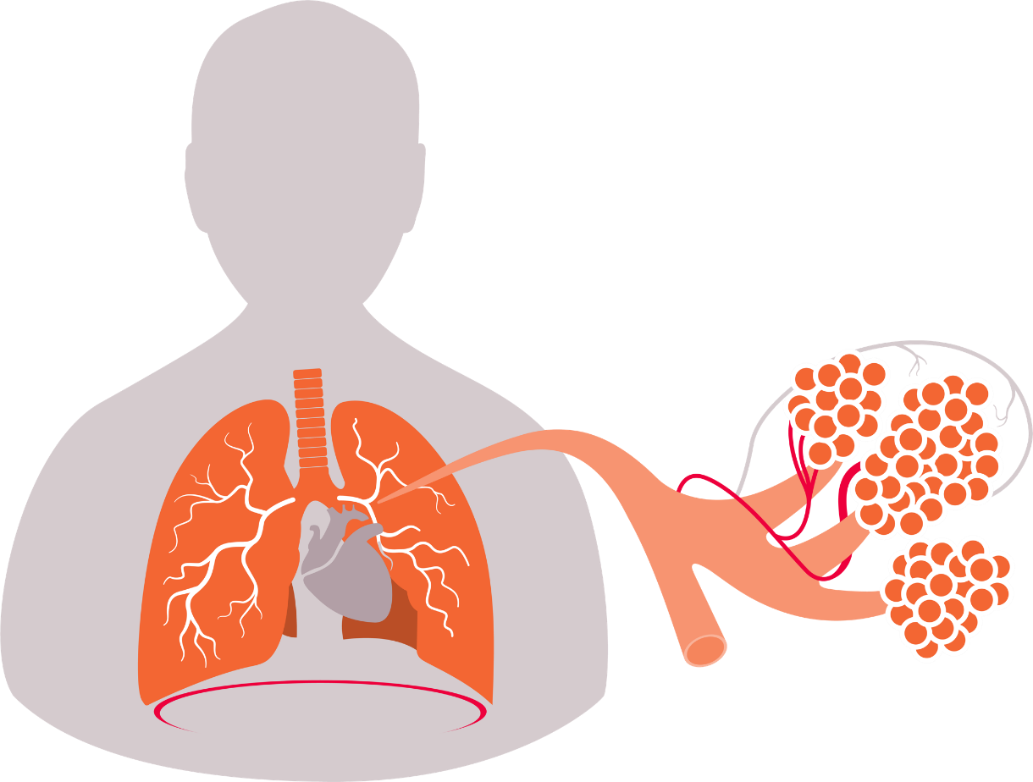
Healthy Lungs and Airways^{1–4}
Pulmonary arteries: Carry de-oxygenated blood from the heart to the lungs
Bronchioles
(tiny airways)
Trachea (windpipe)
Bronchus
Left lung
Network of capillaries surrounding alveoli: Site of gas exchange
Right lung
Alveoli (air sacs)
Thoracic wall
Pulmonary veins: Return oxygenated blood to the
heart where it is pumped
to the rest of the body
Diaphragm
Small airways
1. MacNee W;Clinical Respiratory Medicine;2012;4;531-552; 2. Global Initiative for Chronic Obstructive Lung Disease;GOLD;2023;1-205. Available at: https://goldcopd.org/2023-gold-report-2/. Accessed February 2023; 3. CDC;2003;1-257; Niosh Spirometry Training Guide. Available at: https://www.cdc.gov/niosh/docs/2004-154c/pdfs/2004-154c.pdf. Accessed March 2021; 4. Msdmanuals;2020;1-7;COPD - Lung and Airway Disorders - MSD Manual Consumer Version. Available at: http://www.msdmanuals.com/home/lung-and-airway-disorders/chronic-obstructive-pulmonary-disease-copd/chronic-obstructive-pulmonary-disease-chronic-bronchitis-emphysema. Accessed March 2021.
FOR GSK INTERNAL USE ONLY

Slide 49
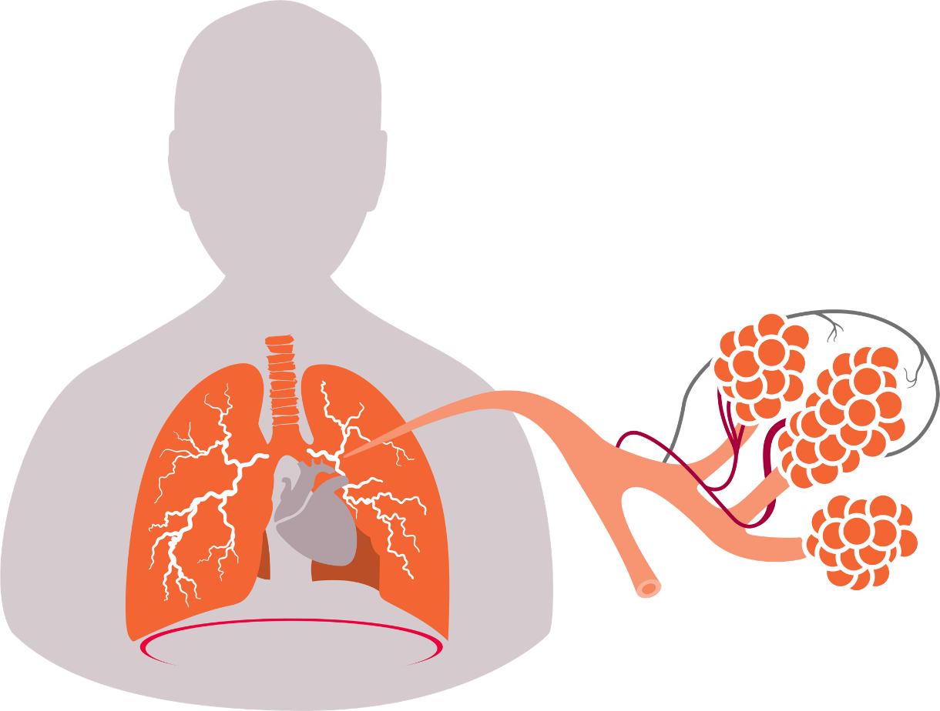
Lungs and Airways in Patients With COPD^{1–4}
COPD: Narrowed airway and mucus hypersecretion in the bronchioles
COPD: Pulmonary arteries carry blood with more CO₂
COPD: Distorted trachea
COPD: Distorted bronchus
Left lung
Network of capillaries surrounding alveoli: Site of gas exchange
Right lung
COPD: Enlarged alveoli with disrupted membranes
Thoracic wall
COPD: Impaired gas exchange leading to oxygen-deprived blood going back to the heart in the pulmonary veins
Diaphragm
COPD: Distorted small airways and damaged alveoli
CO₂, carbon dioxide; COPD, chronic obstructive pulmonary disease.
1. MacNee W;Clinical Respiratory Medicine;2012;4;531-552; 2. Global Initiative for Chronic Obstructive Lung Disease;GOLD;2023;1-205. Available at: https://goldcopd.org/2023-gold-report-2/. Accessed February 2023; 3. CDC;2003;1-257; Niosh Spirometry Training Guide. Available at: https://www.cdc.gov/niosh/docs/2004-154c/pdfs/2004-154c.pdf. Accessed March 2021; 4. Msdmanuals;2020;1-7;COPD - Lung and Airway Disorders - MSD Manual Consumer Version. Available at: http://www.msdmanuals.com/home/lung-and-airway-disorders/chronic-obstructive-pulmonary-disease-copd/chronic-obstructive-pulmonary-disease-chronic-bronchitis-emphysema. Accessed March 2021.
FOR GSK INTERNAL USE ONLY

Slide 50











Overview of the Pathogenesis of COPD
COPD develops as a result of changes in multiple mechanisms in the lungs^{1,2}
All these mechanisms work together, resulting in physiological abnormalities associated with COPD¹
Possible triggers and risk factors for inflammation¹
E.g., cigarette smoke, pollution and viral infections
Innate/adaptive inflammatory immune response
Amplifying processes
E.g., innate and acquired immunity, oxidative stress, protease and antiprotease imbalance
Lung epithelial cells
Cells of the immune system
Cellular processes
E.g., inflammatory cell recruitment/activation, mediator release, apoptosis, impaired tissue repair and autoimmunity
TGF-β
Goblet cells
Fibroblasts
Oxidants |  | Proteases
Increased mucus production
Fibrosis
Alveolar wall
destruction
Let’s explore the roles of different immune cells in the pathogenesis of COPD…
COPD, chronic obstructive pulmonary disease; TGF-β, transforming growth factor beta.
1. MacNee W;Clinical Respiratory Medicine;2012;4;531-552; 2. Global Initiative for Chronic Obstructive Lung Disease;GOLD;2023;1-205. Available at: https://goldcopd.org/2023-gold-report-2/. Accessed February 2023.
FOR GSK INTERNAL USE ONLY

Slide 51


Roles of Different Cells of the Immune System in COPD Pathogenesis (I)
Epithelial cells
 | Epithelial cells present in airways act as protective barriers against foreign substances such as noxious agents and pathogens^{1,2} When exposed to COPD risk factors, these cells react by releasing inflammatory mediators^{1, 2} These include the growth factor TGF-β, which stimulates fibroblast cells and leads to airway fibrosis^{1–3}
Mast cells
 | These cells are present in the bloodstream and play a key role in COPD by releasing histamine that causes airway inflammation⁴ Mast cells stimulate the production of fibroblasts,⁴ which are responsible for the production and maintenance of the extracellular matrix. The matrix is composed of a highly dynamic complex of fibrous proteins (collagen), glycoproteins and proteoglycans⁵ Uncontrolled stimulation of fibroblasts produces a pathological fibrotic (scarring) response that eventually leads to permanent scar tissue formation⁶
COPD, chronic obstructive pulmonary disease; TGF-β, transforming growth factor beta.
1. ACCP Pulmonary Medicine Board Review;Chapter 4;Braman SS;2012;26th Edn;1-39; 2. Asthma and COPD;Chapter 34;Barnes PJ;2009;2;425-442; 3. MacNee W;Clinical Respiratory Medicine;2012;4;531-552; 4. Gosman MM;Respiratory Research;2008;9:64;1-9; 5. White ES;Annals of the American Thoracic Society;2015;12;S30–S33; 6. Hogg JC;Candian Respiratory Journal;2012;19;381-384.
FOR GSK INTERNAL USE ONLY

Slide 52


Roles of Different Cells of the Immune System in COPD Pathogenesis (II)
Eosinophils
 | A type of white blood cell involved in the body's self-defence¹ Eosinophils help promote inflammation, which has a beneficial role in healthy individuals by isolating and controlling a disease site^{2,3} Increased numbers of eosinophils have been shown to be associated with increased severity of symptoms and exacerbations in COPD^{2,3}
T lymphocytes
 | Cells involved in the body’s adaptive immune response and in mediating inflammatory responses⁴ The number of T lymphocytes is significantly increased in the airways of patients with COPD^{5,6} An increase in the number of these cells leads to greater alveolar destruction and increased severity of airflow obstruction⁶
COPD, chronic obstructive pulmonary disease.
1. Jacobsen EA;Blood;2012;120;3882-3890; 2. Varricchi G;Current Opinion in Allergy and Clinical Immunology;2016;16;186--200; 3. Bafadhel M;American Journal of Respiratory and Critical Care Medicine;2011;184;662-671; 4. Warrington R;Allergy, Asthma, and Clinical Immunology;2011;7;1-8; 5. ACCP Pulmonary Medicine Board Review;Chapter 4;Braman SS;2012;26th Edn;1-39; 6. Asthma and COPD;Chapter 34;Barnes PJ;2009;2;425-442.
FOR GSK INTERNAL USE ONLY

Slide 53


Roles of Different Cells of the Immune System in COPD Pathogenesis (III)
Macrophages
 | Large, specialised white blood cells that recognise, engulf and destroy invading harmful foreign cells¹ In COPD, alveolar macrophages play a critical role as orchestrators of inflammation: the number of macrophages increases significantly in the lungs of patients with COPD² Alveolar macrophages secrete many different inflammatory mediators (e.g., TNF-α, LT B4 and IL-8), in response to cigarette smoke and other airborne irritants^{2,3} Mediators released by these, and other inflammatory cells are believed to account for most of the alterations in lung structure, such as alveolar wall destruction, that characterise COPD²
Neutrophils
 | Also, a type of white blood cell that recognises, engulfs and destroys invading harmful foreign cells⁴ Present mainly in the bronchial epithelium and bronchial mucosa, and their number is increased in patients with COPD; these cells produce cytokines and proteases⁴ Cytokines and other similar mediators cause inflammation in the airways, which leads to airflow obstruction and decline in lung function⁴ Neutrophil-derived proteases are key mediators of tissue damage⁴
COPD, chronic obstructive pulmonary disease; IL-8, interleukin-8; LT B4, leukotriene B4; TNF-α, tumour necrosis factor alpha.
1. Aderem A.The Journal of Infectious Disease 2003;187;S340–S345; 2. Asthma and COPD;Chapter 34;Barnes PJ;2009;2;425-442; 3. ACCP Pulmonary Medicine Board Review;Chapter 4;Braman SS;2012;26th Edn;1-39; 4. Hoenderdos K;American Journal of Respiratory Cell and Molecular Biology;2013;48;531-539.
FOR GSK INTERNAL USE ONLY

Slide 54




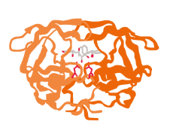
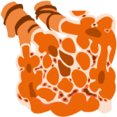

Role of TNF-α in the Inflammatory Response of COPD
TNF-α is an inflammatory mediator released by many different immune cells including alveolar macrophages and T lymphocytes¹
Levels of TNF-α are often found to be elevated in patients with COPD²
TNF-α plays a significant role in the inflammatory response of COPD and leads to connective tissue breakdown and alveolar destruction through the following mechanism:³
COPD risk factors
TNF-α release from stimulated inflammatory cells
Activation of vascular endothelial cells
Entry of neutrophils into the lungs
Destruction of the alveolar walls
Breakdown of connective tissue
Production of neutrophil-derived proteases
COPD, chronic obstructive pulmonary disease; TNF-α, tumour necrosis factor alpha.
1. Mukhopadhyay S;Respiratory Research;2006;7;1-9; 2. Mathanraj S;International Journal of Research in Medical Sciences;2017;5;3309–3316; 3. Churg A;American Journal of Respiratory And Critical Care Medicine;2003;167;1083–1089.
FOR GSK INTERNAL USE ONLY

Slide 55



COPD Pathogenic Mechanisms:
Increased airway inflammation
Inhalation of cigarette smoke or other noxious particles causes lung inflammation¹
An inflammatory response is thought to be a normal, protective, innate immune response to inhaled toxins; this response is amplified in patients who develop COPD^{1,2}
Inflammation in the airways persists even after smoking cessation^{1–3}
Both the innate and acquired inflammatory immune responses are affected in COPD:^{2,3}
COPD risk factors
Increase in the number of inflammatory cells
Increase in inflammatory mediators
Fibrosis and abnormal repair
Recruit inflammatory cells from circulation
Chemotactic factors
Alveolar wall destruction
Induce structural changes
Growth factors
Mucus hypersecretion
Amplify the inflammatory process
Proinflammatory cytokines
COPD, chronic obstructive pulmonary disease.
1. Global Initiative for Chronic Obstructive Lung Disease;GOLD;2023;1-205. Available at: https://goldcopd.org/2023-gold-report-2/. Accessed February 2023; 2. MacNee W;Clinical Respiratory Medicine;2012;4;531-552; 3. Rovina N;Mediators of Inflammation;2013;2013:413735;1-9.
FOR GSK INTERNAL USE ONLY

Slide 56



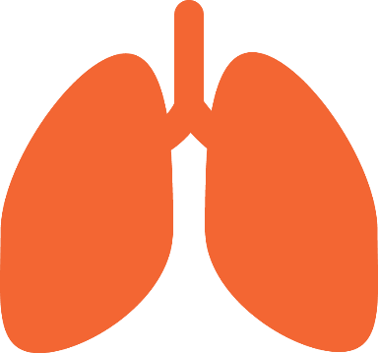

COPD Pathogenic Mechanisms:
Oxidative stress – oxidant and antioxidant imbalance
Oxidative stress arises due to an imbalance between oxidants and antioxidants, wherein free radicals and other reactive oxygen species overwhelm the availability of antioxidants¹
Oxidative stress plays a key role in the pathophysiology of COPD and amplifies the inflammatory process²
Oxidants can be generated from cigarette smoke or other inhaled particles, as well as from activated inflammatory cells³
There may also be a reduction in endogenous antioxidants in patients with COPD as a result of a reduction in the levels of the transcription factor Nrf2, which is known to regulate the expression of a number of genes involved in oxidative stress and inflammation⁴
COPD risk factors
Reactive oxygen species and free radicals dramatically increase^{1,2}
Mucus hypersecretion
Direct damage of cells
Activated inflammatory cells in the lungs
Increased air space
Epithelial permeability
Cellular oxidants
Release of proteases/inactivation of antiproteases
COPD, chronic obstructive pulmonary disease; Nrf2, nuclear factor-E2-related factor.
1. Domej W;International Journal of COPD;2014;9;1207-1224; 2. Asthma and COPD;Chapter 34;Barnes PJ;2009;2;425-442; 3. Global Initiative for Chronic Obstructive Lung Disease;GOLD;2023;1-205. Available at: https://goldcopd.org/2023-gold-report-2/. Accessed February 2023; 4. MacNee W;Clinical Respiratory Medicine;2012;4;531-552.
FOR GSK INTERNAL USE ONLY

Slide 57

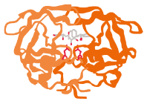
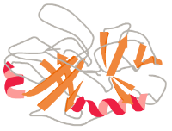





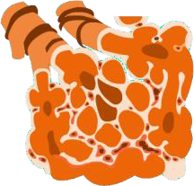
COPD Pathogenic Mechanisms:
Protease and antiprotease imbalance^{1,2}
An imbalance in protease and antiprotease enzymes is thought to contribute to COPD pathology¹
Activated inflammatory cells
Cellular oxidants
Proteases
COPD risk factors
Cigarette smoke and inflammation lead to oxidative stress, which causes inflammatory cells to release proteases and inactivate antiproteases
Antiproteases
Gas exchange in the lung
2. Imbalance
Carbon dioxide
Oxygen
Breakdown of connective tissues by proteases leads to alveolar wall destruction. This impairs gas exchange due to the loss of functional alveoli which are surrounded by the sites of gas exchange - capillaries (i.e., emphysema)
Increased COPD symptoms e.g., dyspnoea*
Alveolar wall destruction → air gets trapped → leads to hyperinflation
*Dysnpoea is a cardinal symptom of COPD, otherwise known as breathlessness.
COPD, chronic obstructive pulmonary disease.
1. MacNee W;Clinical Respiratory Medicine;2012;4;531-552; 2. Asthma and COPD;Chapter 34;Barnes PJ;2009;2;425-442.
FOR GSK INTERNAL USE ONLY

Slide 58
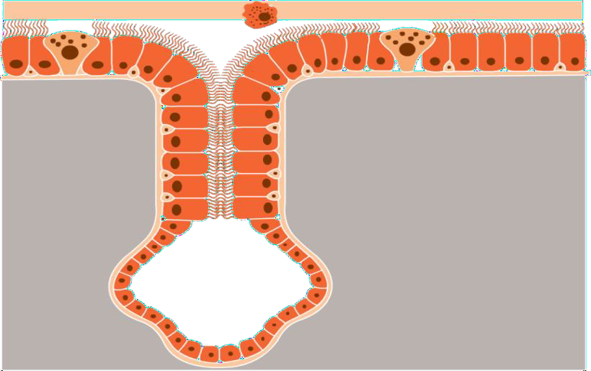
COPD Pathogenic Mechanisms:
Mucus hypersecretion
Airway mucus is part of the lung’s innate immune function that traps foreign particles and microorganisms, enabling their clearance from the lung by ciliary transport and cough¹
Enlarged submucosal glands, increased number of goblet cells, oxidative stress and increased proteases result in airway mucus hypersecretion^{2,3}
The clinical consequences of mucus hypersecretion are airflow limitation and compromised mucociliary clearance due to obstruction of the airway lumen³
Goblet cell
Duct
Mucous layer
Mucous layer
Periciliary layer
Ciliated cells
Basal cell
Submucosal gland
Mucous cells
Structure of airway epithelia and submucosal glands⁴
COPD, chronic obstructive pulmonary disease.
1. Ramos FL;International Journal of COPD;2014;24;139-150; 2. Global Initiative for Chronic Obstructive Lung Disease;GOLD;2023;1-205. Available at: https://goldcopd.org/2023-gold-report-2/. Accessed February 2023; 3. MacNee W;Clinical Respiratory Medicine;2012;4;531-552; 4. Fahy JV;The New England Journal of Medicine; 2010;363;2233-2247.
FOR GSK INTERNAL USE ONLY

Slide 59




COPD Pathogenic Mechanisms:
Tissue remodelling and defective lung repair
How COPD risk factors potentially contribute to lung tissue remodelling and disrupt the repair process:¹
COPD risk factors
Inflammation/injury to the small airways of the lungs
The process of lung repair is disrupted, and permanent tissue remodelling can occur
Alveolar wall destruction
Mucus hypersecretion
Fibrosis
COPD, chronic obstructive pulmonary disease.
1. MacNee W;Clinical Respiratory Medicine;2012;4;531-552.
FOR GSK INTERNAL USE ONLY

Slide 60
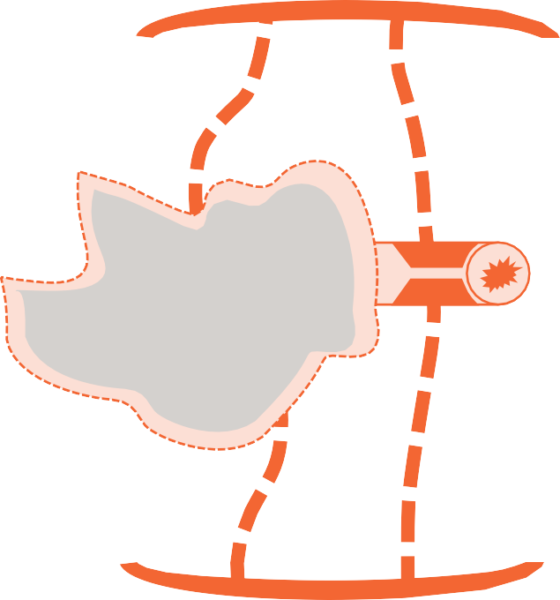
Pathological Consequences of COPD Inflammation
COPD is a multicomponent disease with inflammation at its core¹
Inflammation induces various pathological changes in the lungs of patients with COPD^{1,2}
Resulting physiological changes eventually impact the patient’s quality of life and survival:^{2,3}
Hyperinflation:
Destruction of elastin and narrowing of airways leads to an abnormally high level of inflation of the lungs ²
The lungs attempt to compensate for the loss of elastic fibres with increased traction on airways, which fill with unwanted ‘trapped' air³
Destruction of alveoli and terminal bronchioles results in large air filled spaces³
This can lead to different forms of emphysema, including: panlobular, paraseptal, centrilobular, bullous emphysema³
Narrowed airway results in airflow limitation²
Elasticity of lung tissue is reduced²
Loss of elastic recoil in the alveoli due to excessive breakdown of the protein elastin by protease enzymes³
Alveolar attachment to small airways is destroyed by action of protease enzymes³
Airway remodelling with smooth muscle hypertrophy, fibrosis, inflammation and excessive secretion of mucus all contribute to restriction of airflow³
GSK created image from Brashier BB & Kodgule R. JAPI Suppl 2012; 60:17–21.
COPD, chronic obstructive pulmonary disease.
1. Agusti AG;Respiratory Medicine;2005;99;670-682; 2. Brashier BB;The Journal of the Association of Physicians of India;2012;60;17-21; 3. MacNee W;Clinical Respiratory Medicine;2012;4;531-552
FOR GSK INTERNAL USE ONLY

Slide 61
Pathophysiology of COPD
COPD, chronic obstructive pulmonary disease.
FOR GSK INTERNAL USE ONLY

Slide 62
Pathophysiology of COPD¹
COPD
Airflow limitation and gas trapping
Gas exchange abnormalities
Pulmonary hypertension
Multimorbidity
Exacerbation
The underlying disease process in COPD leads to characteristic physiological abnormalities and symptoms. Let’s explore each of these in turn…
COPD, chronic obstructive pulmonary disease.
1. Global Initiative for Chronic Obstructive Lung Disease;GOLD;2023;1-205. Available at: https://goldcopd.org/2023-gold-report-2/. Accessed February 2023.
FOR GSK INTERNAL USE ONLY

Slide 63
Pathophysiology of COPD
Airflow limitation and gas trapping¹
A mixture of small airways disease (narrowing, luminal exudation and loss of airways) and parenchymal destruction correlate with a reduction in FEV₁ and FEV₁/FVC ratio± The limited emptying of lungs during forced expiration progressively traps gas during each expiration, resulting in hyperinflation Static lung hyperinflation is thought to be one of the main mechanisms causing exertional dyspnoea and limits exercise capacity Lung hyperinflation impacts the contractile properties of the diaphragm and other respiratory muscles
Gas exchange abnormalities
Ventilation-perfusion* mismatching and loss of alveolar tissue (emphysema) are the most important causes of impaired pulmonary gas exchange² Pulmonary gas exchange worsens as the disease progresses¹ Other causes are the changes seen in small airways, pulmonary hypertension and impaired cardiac function² High V_{D}/V_{T}# was the most consistent gas exchange abnormality in smokers with only spirometric abnormalities³ Compensatory increases in minute ventilation during exercise maintained alveolar ventilation and arterial blood gas homeostasis but at the expense of earlier dynamic mechanical constraints, greater dyspnoea and exercise intolerance in mild COPD³
± FEV1/FVC ratio is measurement of amount of air forcefully exhaled from lungs; * volume of gas inhaled and exhaled from the lungs in a given period of time; # VD/VT, ratio of dead space (VD) ventilation to tidal volume (VT).
COPD, chronic obstructive pulmonary disease; FEV1, forced expiratory volume in 1 second; FVC, forced vital capacity.
1. Global Initiative for Chronic Obstructive Lung Disease;GOLD;2023;1-205. Available at: https://goldcopd.org/2023-gold-report-2/. Accessed February 2023; 2. Rodríguez-Roisin R;Journal of Applied Physiology;2009;106;1902-1908; 3. Elbehairy AF;American Journal of Respiratory Critical Care Medicine;2015;191;1384-1394.
FOR GSK INTERNAL USE ONLY

Slide 64
Pathophysiology of COPD
Pulmonary hypertension¹
May develop late in the course of COPD Is due to hypoxic vasoconstriction of the small pulmonary arteries as a result of an inflammatory response in vessels, similar to that seen in the airways May also occur due to loss of pulmonary capillary bed caused by emphysema Progressive pulmonary hypertension may lead to right ventricular hypertrophy and eventually to right-sided heart failure Severe progression worsens survival
Multimorbidity¹
Most patients with COPD suffer concomitant chronic diseases linked to the same risk factors Airflow obstruction and hyperinflation affect cardiac function and gas exchange Inflammatory mediators in circulation may contribute to skeletal muscle wasting and initiate or worsen other comorbidities, e.g., ischaemic heart disease, diabetes, osteoporosis, normocytic anaemia and metabolic syndrome
Exacerbations¹
Acute worsening of respiratory symptoms, resulting in a need for additional therapy Thought to be caused by complex interactions between the host, viruses, bacteria and environmental pollution During an exacerbation there is increased hyperinflation, increased airway and systemic inflammation and gas trapping, with reduced expiratory flow, causing an increase in dyspnoea Other conditions like pneumonia, thromboembolism and acute cardiac failure may mimic or aggravate an exacerbation
COPD, chronic obstructive pulmonary disease; EGFR, epidermal growth factor receptor.
1. Global Initiative for Chronic Obstructive Lung Disease;GOLD;2023;1-205. Available at: https://goldcopd.org/2023-gold-report-2/. Accessed February 2023.
FOR GSK INTERNAL USE ONLY

Slide 65


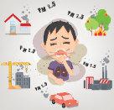


COPD Exacerbations are Episodes of Symptom Worsening
Exacerbations:
Thought to be caused by complex interactions between the host, viruses, bacteria and environmental pollution¹
Oxidative stress is further increased during exacerbations¹
These factors increase the inflammatory burden in the lower airways, overwhelming the body’s natural protective anti‐inflammatory defences and so leads to increased tissue damage³
Severe exacerbations are defined as those which require hospitalisation or visits to the emergency room. Hospitalisation for a COPD exacerbation is associated with poor prognosis and increased risk of death¹
Exacerbation triggers and consequences²
Trigger
Bacteria
Viruses
Pollutants
Narrowed lumen
Effects
Mucus
Inflamed COPD airway
Normal lung and airway
Inflamed lung and airway
Greater airway inflammation
Bronchoconstriction, oedema, mucus hypersecretion
Systemic inflammation
Expiratory flow limitation
Cardiovascular comorbidity
Exacerbation of symptoms
Dynamic hyperinflation
COPD, chronic obstructive pulmonary disease.
1. Global Initiative for Chronic Obstructive Lung Disease;GOLD;2023;1-205. Available at: https://goldcopd.org/2023-gold-report-2/. Accessed February 2023; 2. Wedzicha JA;Breathe;2013;9;435-440; 3. Rovina N;Mediators of inflammation;2013;2013:413735;1-9.
FOR GSK INTERNAL USE ONLY

Slide 66

Summary
COPD develops in patients as a result of changes in multiple mechanisms (e.g., increased airway inflammation, protease/antiprotease imbalance, oxidative stress) that work together, resulting in the physiological abnormalities associated with COPD^{1,2}
Epithelial cells and multiple cells of the immune system are involved in the inflammatory response which leads to mucus hypersecretion, fibrosis and destruction of the alveolar wall^{1,2}
Airflow limitation and gas trapping, gas exchange abnormalities, pulmonary hypertension, exacerbations and multimorbidity form a part of the pathophysiology of COPD^{1,2}
Exacerbations are thought to be triggered by viruses, bacteria and environmental pollution, resulting in a greater inflammatory response and an acute worsening of respiratory symptoms²
COPD, chronic obstructive pulmonary disease.
1. MacNee W;Clinical Respiratory Medicine;2012;4;531-552; 2. Global Initiative for Chronic Obstructive Lung Disease;GOLD;2023;1-205. Available at: https://goldcopd.org/2023-gold-report-2/. Accessed February 2023.
FOR GSK INTERNAL USE ONLY

Slide 67
COPD diagnosis and assessment

Slide 68
Diagnosis of COPD
“A diagnosis of COPD should be considered in any patient who has dyspnea, chronic cough or sputum production, a history of recurrent lower respiratory tract infections and/or a history of exposure to risk factors for the disease”
Spirometry that demonstrates a post-bronchodilator ratio of FEV₁/FVC < 0.70 confirming airflow obstruction is required to establish the diagnosis
Symptoms
Dyspnea*
Recurrent wheeze
Chronic cough†
Recurrent lower respiratory tract infection
Risk factors
Host factors‡
Tobacco
Smoke from cooking and heating fuels
Occupational dusts, vapours, gases and other chemicals
Spirometry
Required to establish COPD diagnosis
If there is a marked discordance between the level of airflow obstruction and perceived symptoms, additional tests may be undertaken, such as
Physiological evaluations to assess the severity of COPD (eg, measurement of lung volumes and carbon monoxide diffusing capacity of the lungs)
Exercise testing for assessing disability, mortality risk and effectiveness of pulmonary rehabilitation (eg, 6-minute walk and treadmill)
Imaging for differential diagnosis (eg, chest X-ray and CT scan)
Blood test(s) for evaluating disease severity (eg, measuring blood eosinophil count to identify patients with a high exacerbation risk)
Oximetry and ABG for evaluating patients' arterial oxygen saturation
Composite score for identifying disease severity using a combination of variables such as exercise intolerance and weight loss
Assessment of treatable traits for addressing heterogeneity and complexity of COPD in clinical practice (eg, persistent dyspnea and exacerbations)
*Dyspnea that is progressive over time, worse with exercise or persistent. †May be intermittent and unproductive. ‡Includes genetic factors, developmental abnormalities, low birthweight, prematurity and childhood respiratory infections.
ABG, arterial blood gas; CT, computerised tomography; FEV₁, forced expiratory volume in 1 second; FVC, forced vital capacity
Global Initiative for Chronic Obstructive Lung Disease. 2023 GOLD Report. https://goldcopd.org/wp-content/uploads/2023/01/GOLD-2023-ver-1.2-7Jan2023_WMV.pdf. Accessed February 15, 2023.

Slide 69
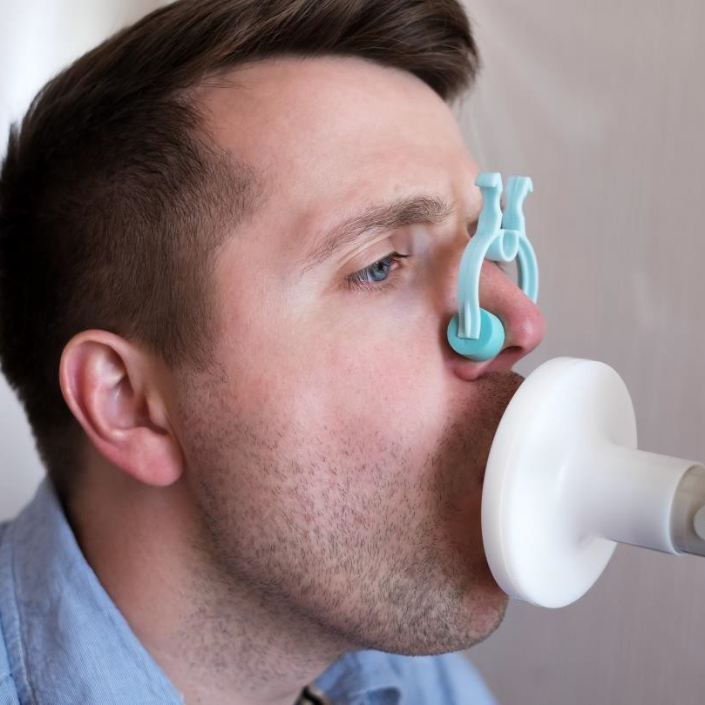
Spirometry
A non-invasive, reproducible, cheap and readily available test to measure airflow obstruction objectively
Measures i) the volume of air forcibly exhaled from the point of maximal inspiration (ie, FVC) and ii) the volume of air exhaled during the first second of this maneuver (ie, FEV₁)
Diagnosis of COPD and determination of spirometric grades (severity of airflow limitation) are based on FEV₁ and FVC
FEV₁, forced expiratory volume in 1 second; FVC, forced vital capacity
Global Initiative for Chronic Obstructive Lung Disease. 2023 GOLD Report. https://goldcopd.org/wp-content/uploads/2023/01/GOLD-2023-ver-1.2-7Jan2023_WMV.pdf. Accessed February 15, 2023.

Slide 70
Assessment of COPD
Goals of initial COPD
assessment
Determine the severity of airflow obstruction
Determine the impact of disease on the patient’s health status
Determine the risk of future events such as exacerbations or death
To guide therapy, COPD assessment must focus on the following 4 fundamental aspects:
Severity of airflow limitation
GOLD grades based on post-bronchodilator FEV₁ are used to assess the severity of airflow limitation
Nature and magnitude of current symptoms
Validated questionnaires (eg, mMRC scale, SGRQ, CRQ and CAT™) are used to determine the nature and magnitude of symptoms
Previous history of moderate and severe exacerbations
Presence and type of other diseases (multimorbidity)
CAT, COPD Assessment Test; CRQ, Chronic Respiratory Questionnaire; FEV₁, forced expiratory volume in 1 second; GOLD, Global Initiative for Chronic Obstructive Lung Disease; mMRC, modified Medical Research Council; SGRQ, St George’s Respiratory Questionnaire
Global Initiative for Chronic Obstructive Lung Disease. 2023 GOLD Report. https://goldcopd.org/wp-content/uploads/2023/01/GOLD-2023-ver-1.2-7Jan2023_WMV.pdf. Accessed February 15, 2023.

Slide 71
Assessment of COPD symptoms (1)
Questionnaires used for assessment of symptom severity¹
mMRC Scale¹
CAT™¹
SGRQ¹
CCQ¹
E-RS: COPD²
The mMRC scale was the first questionnaire that was developed to measure breathlessness, a key symptom in many patients with COPD¹
However, the GOLD 2023 now acknowledges that “COPD impacts patients beyond just dyspnoea. For this reason, multidimensional questionnaire is recommended”¹
CAT, COPD Assessment Test; CCQ, COPD Control Questionnaire; E-RS: COPD, Evaluating Respiratory Symptoms in Chronic Obstructive Pulmonary Disease; GOLD, Global Initiative for Chronic Obstructive Lung Disease; mMRC, modified Medical Research Council; SGRQ, St George’s Respiratory Questionnaire
1. Global Initiative for Chronic Obstructive Lung Disease. 2023 GOLD Report. https://goldcopd.org/wp-content/uploads/2023/01/GOLD-2023-ver-1.2-7Jan2023_WMV.pdf. Accessed February 15, 2023; 2. EXACT-PRO Initiative;2021;1-4;E-RS COPD.

Slide 72
Assessment of COPD symptoms (2)
As COPD is a complex disease, additional assessments such as a multidimensional
symptomatic assessment beyond the use of the mMRC scale may be required
mMRC Scale¹
CAT™¹
SGRQ¹
CCQ¹
E-RS: COPD²
Measure of dyspnea
Measure of health status
Measure of disease-specific health status
Measure of disease-specific health status
Evaluation of the effect of treatment on the severity of exacerbations and respiratory symptoms
Assessment of dyspnea only
Multidimensional symptomatic assessment
CAT, COPD Assessment Test; CCQ, COPD Control Questionnaire; E-RS: COPD, Evaluating Respiratory Symptoms in Chronic Obstructive Pulmonary Disease; mMRC, modified Medical Research Council; SGRQ, St George’s Respiratory Questionnaire
1 Global Initiative for Chronic Obstructive Lung Disease. 2023 GOLD Report. https://goldcopd.org/wp-content/uploads/2023/01/GOLD-2023-ver-1.2-7Jan2023_WMV.pdf. Accessed February 15, 2023; 2. EXACT-PRO Initiative;2021;1-4;E-RS COPD.

Slide 73
The mMRC scale
The mMRC is a 5-item tool, with grades 0 (“breathless with strenuous exercise”) to 4 (“too breathless to leave the house” or “breathless when dressing or undressing”)
Please tick in the box that applies to you (1 box only; grades 0–4)
mMRC | Grade 0 | I only get breathless with strenuous exercise
mMRC | Grade 1 | I get short of breath when hurrying on the level or walking up a slight hill
mMRC | Grade 2 | I walk slower than people of the same age on the level because of breathlessness or I have to stop for breath when walking on my own pace on the level
mMRC | Grade 3 | I stop for breath after walking about 100 meters or after a few minutes on the level
mMRC | Grade 4 | I am too breathless to leave the house or I am breathless when dressing or undressing
Note: The full questionnaire is available in reference 2.
mMRC, modified Medical Research Council
1. Global Initiative for Chronic Obstructive Lung Disease. 2023 GOLD Report. https://goldcopd.org/wp-content/uploads/2023/01/GOLD-2023-ver-1.2-7Jan2023_WMV.pdf. Accessed February 15, 2023; 2. American Thoracic Society. Am Rev Respir Dis. 1982;126:952-956.

Slide 74
The CAT™
The CAT is an 8-item unidimensional scale developed to be applicable worldwide¹
Scores range from 0 to 40, with a higher score indicating a worse health status¹
A score ≥ 10 should be used as the cutoff for considering regular treatment¹
SCORE
I never cough
0
1
2
3
4
5
I cough all the time
I have no phlegm (mucus) in my chest at all
0
1
2
3
4
5
My chest is completely full of phlegm (mucus)
My chest does not feel tight at all
0
1
2
3
4
5
My chest feels very tight
When I walk up a hill or 1 flight of stairs, I am not breathless
0
1
2
3
4
5
When I walk up a hill or 1 flight of stairs, I am very breathless
I am not limited doing any activities at home
0
1
2
3
4
5
I am very limited doing any activities at home
I am confident leaving my home despite my lung condition
0
1
2
3
4
5
I am not at all confident leaving my home because of my lung condition
I sleep soundly
0
1
2
3
4
5
I don’t sleep soundly because of my lung condition
I have lots of energy
0
1
2
3
4
5
I have no energy at all
TOTAL SCORE
Note: The full questionnaire is available in reference 2.
CAT, COPD Assessment Test
1. Global Initiative for Chronic Obstructive Lung Disease. 2023 GOLD Report. https://goldcopd.org/wp-content/uploads/2023/01/GOLD-2023-ver-1.2-7Jan2023_WMV.pdf. Accessed February 15, 2023; 2. Jones PW, et al. Eur Respir J. 2009;34:648‐654.

Slide 75
The SGRQ
The SGRQ is the most widely documented comprehensive questionnaire¹
It is a 50-item questionnaire, producing 3 component scores and a total score²
Items are weighted to support scaling and the total score ranges from 0 to 100, with a higher score indicating a worse health status²
A score ≥ 25 should be used as the cutoff for considering regular treatment¹
It is divided into 3 parts, measuring symptoms, activity limitation and impact of the disease and includes questions such as²
 | Most days a week | Several days a week | A few days a month | Only with chest infections | Not at all
Over the past 3 months, I have coughed | □ | □ | □ | □ | □
Over the past 3 months, I have brought up phlegm (sputum) | □ | □ | □ | □ | □
Over the past 3 months, I have had attacks of wheezing | □ | □ | □ | □ | □
Over the past 3 months, I have had shortness of breath | □ | □ | □ | □ | □
 | True | False
I cannot play sports or games | □ | □
I cannot go out for entertainment or recreation | □ | □
I cannot go out of the house to do shopping | □ | □
I cannot do housework | □ | □
Note: The full questionnaire is available from https://www.sgul.ac.uk/research/research-operations/research-administration/st-georges-respiratory-questionnaire.
SGRQ, St George’s Respiratory Questionnaire
1. Global Initiative for Chronic Obstructive Lung Disease. 2023 GOLD Report. https://goldcopd.org/wp-content/uploads/2023/01/GOLD-2023-ver-1.2-7Jan2023_WMV.pdf. Accessed February 15, 2023; 2. American Thoracic Society. St. George’s Respiratory Questionnaire. https://www.thoracic.org/members/assemblies/assemblies/srn/questionaires/sgrq.php. Accessed February 22, 2023.

Slide 76
COPD Control Questionnaire (CCQ)
The CCQ was developed to measure the health status of patients with COPD and comprises 10 items categorised into 3 domains:³
Symptoms
Functional state
Mental state
Two versions of the CCQ are available:
One version assessing symptoms over the past week1 and one over the past 24 hours²
Sample questions include the following:^{1,2}
Please circle the number of the response that best describes how you have been feeling during the past week (only 1 response for each question)
On average, during the past week, how often did you feel | Never | Hardly ever | A few times | Several times | Many times | A great many times | Almost all the time
1. Short of breath at rest? | 0 | 1 | 2 | 3 | 4 | 5 | 6
2. Short of breath doing physical activities? | 0 | 1 | 2 | 3 | 4 | 5 | 6
3. Concerned about getting a cold or your breathing getting worse? | 0 | 1 | 2 | 3 | 4 | 5 | 6
4. Depressed (down) because of your breathing problems? | 0 | 1 | 2 | 3 | 4 | 5 | 6
Note: The full questionnaire is available from https://ccq.nl/?page_id=4.
1. Clinical COPD Questionnaire one week. https://ccq.nl/?page_id=4. Accessed February 22, 2023; 2. Clinical COPD Questionnaire 24 hours. https://ccq.nl/?page_id=4. Accessed February 22, 2023; 3. Zhou Z, et al. Int J Chron Obstruct Pulmon Dis. 2018;13:1675-1682.

Slide 77
Evaluating Respiratory Symptoms in COPD (E-RS: COPD)
The E-RS: COPD is used to measure the effect of treatment on the severity of respiratory symptoms in stable COPD^{1,2}
It contains 11 respiratory symptom items and is a part of the 14-item EXAcerbations of Chronic pulmonary disease Tool (EXACT) which is used to quantify and measure COPD exacerbations^{1,2}
The E-RS: COPD is always performed together with the EXACT, allowing 1 set of questions to have 2 uses^{1,2}
The RS-Total score is computed by taking the sum of the items comprising the questionnaire and ranges from 0 to 40, with higher values indicating more severe respiratory symptoms¹
There are also 3 subscales which are determined from the sum of the relevant items: RS-Breathlessness, RS-Cough & Sputum and RS-Chest Symptoms¹
1. Did your chest feel congested today? | 0. Not at all
 | 1. Slightly
1. Did your chest feel congested today? | 2. Moderately
 | 3. Severely
 | 4. Extremely
2. How often did you cough today? | 0. Not at all
 | 1. Rarely
2. How often did you cough today? | 2. Occasionally
 | 3. Frequently
 | 4. Almost constantly
Note: The full questionnaire is available from http://www.ema.europa.eu/docs/en_GB/document_library/Other/2015/04/WC500185443.pdf.
1. Evidera E-RS user manual Version 3.1. http://www.ema.europa.eu/docs/en_GB/document_library/Other/2015/04/WC500185443.pdf. Accessed February 22, 2023; 2. EXACT-PRO Initiative;2021;1-4;E-RS COPD.

Slide 78
COPD management and treatment

Slide 79
Goals for the management of stable COPD
COPD is a treatable disease, and HCPs generally manage the disease by¹
Reducing symptoms
Reducing risk
Relieving symptoms
Improving exercise tolerance
Improving health status
Preventing disease progression
Preventing and treating exacerbations
Reducing mortality
Patients with COPD have differing needs due to the heterogeneous nature of the disease and varying comorbidities^{1,2}
Patients do not always recognise the impact of COPD on their lives, making treatment even more challenging³
COPD is a progressive disease, and a different combination of therapies are used based on disease severity¹
HCPs can use a combination of pharmacological and non-pharmacological approaches⁴
HCP, healthcare professional
1. Global Initiative for Chronic Obstructive Lung Disease. 2023 GOLD Report. https://goldcopd.org/wp-content/uploads/2023/01/GOLD-2023-ver-1.2-7Jan2023_WMV.pdf. Accessed February 15, 2023; 2. Agusti A, et al. Respir Res. 2010;11(1):122; 3. Carlone S, et al. Multidiscip Respir Med. 2014;9(1):58; 4. Braman SS. Chapter 4. In: ACCP Pulmonary Medicine Board Review. 26th ed. 2012:1-39.

Slide 80
Pharmacological approaches for the management of COPD (1)
Pharmacological treatments are used to reduce symptoms and the risk and severity of exacerbations and to improve health status and exercise tolerance
Individualised pharmacological management of COPD should be based on
Symptom severity
Risk of exacerbations
Side effects
Comorbidities
Drug availability
Patient response
Preference
Ability to use drug delivery device
The initial pharmacological treatment should be based on the individualised assessment of symptoms and risk of exacerbations
Global Initiative for Chronic Obstructive Lung Disease. 2023 GOLD Report. https://goldcopd.org/wp-content/uploads/2023/01/GOLD-2023-ver-1.2-7Jan2023_WMV.pdf. Accessed February 15, 2023.

Slide 81
Pharmacological approaches for the management of COPD (2)
A range of pharmacological interventions is available, such as
Bronchodilators
Anti-inflammatory agents
β₂ agonists
eg, SABA and LABA
Anticholinergics eg, SAMA and LAMA
Methylxanthines
ICS
Other anti-inflammatory agents
eg, mucolytic agents, PDE4 inhibitors and antibiotics
Combination therapy eg, LAMA + LABA, ICS + LABA, ICS + LABA + LAMA
Inhaled bronchodilators are regularly used to prevent or reduce symptoms
Combination treatment with SABA + SAMA or LABA + LAMA improves FEV₁ and symptoms compared with monotherapy
Long-term monotherapy with ICS is not recommended. The regular use of ICS increases the risk of pneumonia especially in patients with severe COPD
The use of ICS + LABA in COPD is not encouraged. If there is an indication for an ICS, triple therapy with ICS + LABA + LAMA is preferred over ICS + LABA as it improves symptoms, lung function and health status and reduces exacerbations
Single inhaler therapy may be more convenient and effective than multiple inhaler therapy
The choice of medicine within each class depends on the medication availability and patient’s responses and preferences
FEV₁, forced expiratory volume in 1 second; ICS, inhaled corticosteroid; LABA, long-acting β2 agonist; LAMA, long-acting muscarinic antagonist; PDE4, phosphodiesterase-4; SABA, short-acting β2 agonist; SAMA, short-acting muscarinic antagonist
Global Initiative for Chronic Obstructive Lung Disease. 2023 GOLD Report. https://goldcopd.org/wp-content/uploads/2023/01/GOLD-2023-ver-1.2-7Jan2023_WMV.pdf. Accessed February 15, 2023.

Slide 82
GOLD 2025: Classification grid for COPD
GOLD 2025 proposes the ABE assessment tool* derived from the ABCD combined assessment tool that recognises the clinical relevance of exacerbations, independently of the level of symptoms
The A and B groups remain unchanged, but the C and D groups are merged into a single group termed “E” to highlight the clinical relevance of exacerbations
Spirometrically
confirmed diagnosis
Post-bronchodilator FEV₁/FVC < 0.7
Assessment of symptoms/ risk of exacerbations
≥ 2 moderate exacerbations or ≥ 1 leading to hospitalisation
E
Assessment of airflow limitation (spirometric grade)
Grade
GOLD 1
GOLD 2
GOLD 3
GOLD 4
Exacerbation history
0–1 exacerbation not leading to hospitalisation
A
B
FEV₁
(% predicted)
≥ 80
50–79
30–49
< 30
mMRC 0–1 CAT < 10
mMRC ≥ 2 CAT ≥ 10
Symptoms
*Different countries may use different assessment tools. Please refer to the local guidelines.
CAT, COPD Assessment Test; FEV₁, forced expiratory volume in 1 second; FVC, forced vital capacity; GOLD, Global Initiative for Chronic Obstructive Lung Disease; mMRC, modified Medical Research Council
Global Initiative for Chronic Obstructive Lung Disease. 2023 GOLD Report. https://goldcopd.org/wp-content/uploads/2023/01/GOLD-2023-ver-1.2-7Jan2023_WMV.pdf. Accessed February 15, 2023.

Slide 83
GOLD 2025: Initial pharmacological treatment algorithm
GOLD 2025 recommends the initiation of pharmacological management of COPD based on individualised assessment of symptoms and risk of exacerbations following the assessment of “ABE” groups
≥ 2 moderate exacerbations or ≥ 1 leading to hospitalisation
Group E†
LABA + LAMA*
Consider LABA + LAMA + ICS* if blood eos ≥ 300
Exacerbation history
0–1 exacerbation not leading to hospitalisation
Group A
A bronchodilator
Group B
LABA + LAMA*
mMRC 0–1 CAT < 10
mMRC ≥ 2 CAT ≥ 10
Symptoms
†In the presence of concomitant asthma, patients with COPD should be treated like patients with asthma. In this circumstance, the use of ICS is required. *Single inhaler therapy may be more convenient and effective than multiple inhaler therapy.
CAT, COPD Assessment Test; eos, blood eosinophil count (cells/µL); GOLD, Global Initiative for Chronic Obstructive Lung Disease; ICS, inhaled corticosteroid; LABA, long-acting β2 agonist; LAMA, long-acting muscarinic antagonist; mMRC, modified Medical Research Council
Global Initiative for Chronic Obstructive Lung Disease. 2023 GOLD Report. https://goldcopd.org/wp-content/uploads/2023/01/GOLD-2023-ver-1.2-7Jan2023_WMV.pdf. Accessed February 15, 2023.

Slide 84
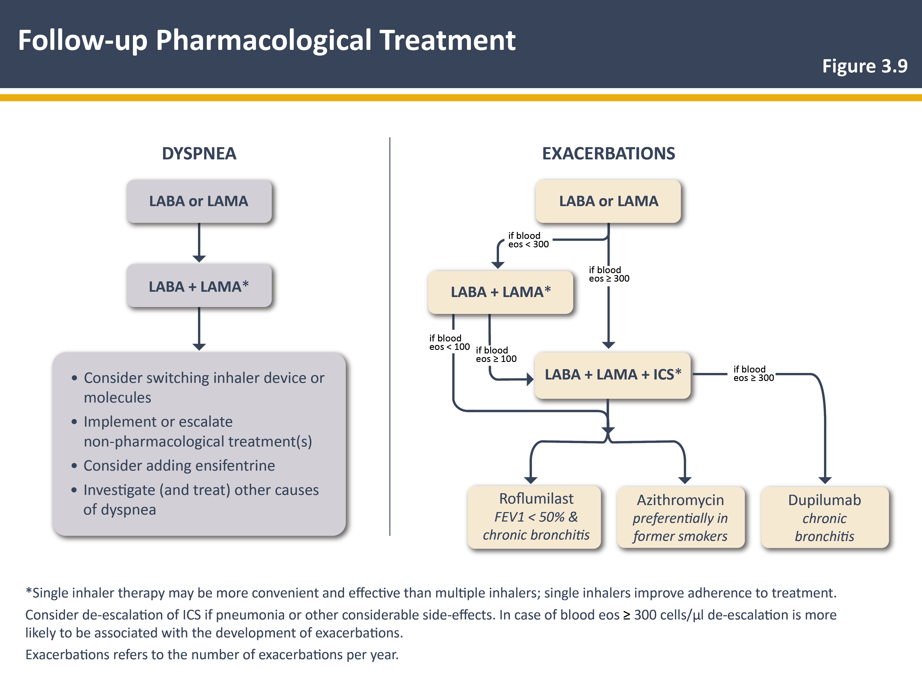

GOLD 2025: Follow-up pharmacological treatment algorithm
2025 REPORT
If response to initial treatment is appropriate, maintain the treatment. If not:
Check adherence, inhaler technique, and possible interfering comorbidities
The need to target primarily dyspnea/activity limitation or to prevent further exacerbations should be evaluated in each patient. Consider the predominant treatable trait to target (dyspnea or exacerbations)
If a change in treatment is considered necessary, the corresponding algorithms can be selected:
Left column for dyspnea or
Right column for exacerbations
The exacerbation pathway should be used if both dyspnea and exacerbations need to be targeted
The algorithm is revised to include new treatments—ensifentrine for dyspnea and dupilumab for patients who continue to exacerbate despite triple inhaler therapy in patients with raised eos + chronic bronchitis
GOLD provides COPD management recommendations for drug classes, not specific products.
The figure is used with the permission of © [2024 and 2025] Global Strategy for Diagnosis, Management and Prevention of COPD all rights reserved. Use is by express license from the owner. The same data can be found in GOLD. Global Strategy for the Diagnosis, Management and Prevention of COPD. 2025.
eos, eosinophil; FEV₁, forced expiratory volume in 1 second; GOLD, Global Initiative for Chronic Obstructive Lung Disease; ICS, inhaled corticosteroid; LABA, long-acting β₂-agonist; LAMA, long-acting muscarinic antagonist.
Global Initiative for Chronic Obstructive Lung Disease. Global Strategy for the Diagnosis, Management, and Prevention of Chronic Obstructive Pulmonary Disease (2025 Report). https://goldcopd.org/wp-content/uploads/2024/11/GOLD-2025-Report-v1.0-15Nov2024_WMV.pdf. Accessed November 21, 2024.
Notes:
Ensifentrine, sold under the brand name Ohtuvayre, is a medication used for the treatment of chronic obstructive pulmonary disease (COPD) in adults. It is a phosphodiesterase 3 inhibitor and phosphodiesterase 4 inhibitor. It is given by inhalation. PDE3 inhibitors act as bronchodilators, while PDE4

Slide 85
The role of non-pharmacological interventions for stable COPD
Non-pharmacological treatment is complementary to pharmacological treatment and should be a part of comprehensive COPD management
Recommendations for follow-up non-pharmacological treatment are based on the patient’s treatable traits, eg, symptoms and exacerbations
GOLD 2023 recommendations | Group A | Group B | Group E
Smoking cessation
Pulmonary Rehabilitation | NA
Physical activity
Flu vaccination
Pneumococcal vaccination
Pertussis vaccination
Shingles vaccination
COVID-19 vaccination
RSV vaccination
Essential
Recommended
Local guidelines
Note: These non-pharmacological treatments can be accompanied by pharmacological treatment.
COVID-19, Coronavirus disease 2019; GOLD, Global Initiative for Chronic Obstructive Lung Disease; NA, not applicable.
Global Initiative for Chronic Obstructive Lung Disease. Global Strategy for the Diagnosis, Management, and Prevention of Chronic Obstructive Pulmonary Disease (2025 Report). https://goldcopd.org/wp-content/uploads/2024/11/GOLD-2025-Report-v1.0-15Nov2024_WMV.pdf. Accessed November 21, 2024.

Slide 86
Pulmonary rehabilitation: Key components
Patients with a high symptom burden and risk of exacerbations (groups B and E) should be encouraged to undergo pulmonary rehabilitation, which is a comprehensive intervention based on thorough patient assessment followed by patient-tailored therapies. These include but are not limited to^{1,2}
Maintenance
strategies
Self management
Diagnosis and management of comorbidities
Optimisation of pharmaco- therapy
Pulmonary rehabilitation
Exercise training and maintenance
Facilitation of smoking cessation
Management of acute dyspnea
Nutritional support
1. Hill K, et al. Eur Respir Rev. 2013;22(129):405-413; 2. Global Initiative for Chronic Obstructive Lung Disease. 2023 GOLD Report. https://goldcopd.org/wp-content/uploads/2023/01/GOLD-2023-ver-1.2-7Jan2023_WMV.pdf. Accessed February 15, 2023.

Slide 87
Understanding the need for individualised treatment in COPD

Slide 88



Patients with COPD have varying treatment needs
Characterisation of different clinical COPD exacerbation phenotypes¹
Assessment of sputum for etiological and/or inflammatory causes of exacerbations* identified the following exacerbation phenotypes:
COPD is a complex,
heterogeneous disease²
Viral-associated exacerbations
10%
12%
Several different exacerbation phenotypes have been identified and each may be more responsive to certain treatment regimens than to others¹
1%
3%
Bacterial-associated exacerbations
37%
Sputum eosinophilia- associated exacerbations
17%
6%
Effective management of COPD should be based on the individual assessment of
symptoms and future risk of exacerbations²
*Assessment of 182 COPD exacerbations (86 patients); no etiological or inflammatory causes were identified in 14% of exacerbations.¹
1. Bafadhel M, et al. Am J Respir Crit Care Med. 2011;184(6):662-671; 2. Global Initiative for Chronic Obstructive Lung Disease. 2023 GOLD Report. https://goldcopd.org/wp-content/uploads/2023/01/GOLD-2023-ver-1.2-7Jan2023_WMV.pdf. Accessed February 15, 2023.

Slide 89
Blood eosinophils as a biomarker of exacerbations and ICS effect in COPD: Post hoc analysis of 2 parallel, randomised controlled trials
No relationship between blood eosinophils and exacerbations (with ICS treatment)
Higher rate of exacerbations with higher blood eosinophils (no ICS treatment)
n = 85
≥ 6%
P = 0.0020
n = 281
n = 113
4 to < 6%
P = 0.0128
n = 395
Blood eosinophil count group
Annual exacerbation rate (patient per year)
n = 302
2 to < 4%
n = 907
P = 0.0045
n = 299
P = 0.2804
< 2%
n = 799
0
0.1
0.2
0.3
0.4
0.5
0.6
0.7
0.8
0.9
1.0
1.1
1.2
1.3
1.4
1.5
1.6
1.7
ICS + LABA
LABA
GSK created from: Pascoe S, et al.
ICS, inhaled corticosteroid; LABA, long-acting β2 agonist
Pascoe S, et al. Lancet Respir Med. 2015;3(6):435-442.

Slide 90





Blood eosinophils as a biomarker of exacerbations and ICS effect in COPD*
Blood eosinophils are associated with exacerbation frequency^{1,2}
Although currently not commonly used in clinical practice, post hoc analyses of blood eosinophil counts show that it is a consistent biomarker of the probability of treatment benefit with an ICS-containing regimen^{1,3}
Blood eosinophil counts (≥ 300 cells/µL) help to identify patients with COPD at a higher risk of exacerbations and more likely to benefit from preventive treatment with ICS³
It is recommended to consider the threshold of < 100 cells/µL and ≥ 300 cells/µL as estimates, rather than precise cutoff values, that can predict different probabilities of treatment benefits³
Use of blood eosinophil counts to aid treatment choices may help to provide the right treatment to the right patient³
*The use of blood eosinophils as a biomarker, while a part of GSK’s strategy, is currently not commonly used in real-world clinical practice.
ICS, inhaled corticosteroid
1. Pascoe S, et al. Lancet Respir Med. 2015;3(6):435-442; 2. Watz H, et al. Lancet Respir Med. 2016;4(5):390-398; 3. Global Initiative for Chronic Obstructive Lung Disease. 2023 GOLD Report. https://goldcopd.org/wp-content/uploads/2023/01/GOLD-2023-ver-1.2-7Jan2023_WMV.pdf. Accessed February 15, 2023.

Slide 91
Monitoring of COPD

Slide 92
Monitoring of COPD
Symptoms, exacerbations and the level of airflow obstructions should be monitored to determine when to modify management and to identify any complication and/or comorbidities that may develop
Virtual and hybrid virtual/in-person care models may improve healthcare access, outcomes and affordability
Monitoring of COPD involves investigating the following:
Monitoring
Spirometry to measure decline in FEV₁
Symptoms (eg, cough, sputum, breathlessness and fatigue)
Smoking status
Severity, frequency, type and likely causes of exacerbations
Comorbidities (eg, lung cancer and congestive heart failure)
Adherence and appropriate use of prescribed treatments
FEV₁, forced expiratory volume in 1 second
Global Initiative for Chronic Obstructive Lung Disease. 2023 GOLD Report. https://goldcopd.org/wp-content/uploads/2023/01/GOLD-2023-ver-1.2-7Jan2023_WMV.pdf. Accessed February 15, 2023.

Slide 93
Monitoring of COPD for adjustment of pharmacotherapy
Adherence and appropriate use of prescribed treatments should be monitored at each clinical visit to decide treatment modification
Careful and personalised monitoring of the following aspects is required:
Monitoring for adjustment of therapy
Dosage of prescribed medication
Adherence to the regimen
Effectiveness of the current regimen
Inhaler technique
Side effects
Global Initiative for Chronic Obstructive Lung Disease. 2023 GOLD Report. https://goldcopd.org/wp-content/uploads/2023/01/GOLD-2023-ver-1.2-7Jan2023_WMV.pdf. Accessed February 15, 2023.

Slide 94
Non-adherence and poor inhaler technique in COPD

Slide 95



Monitoring of COPD for adjustment of pharmacotherapy
Only 40%–60% of patients with COPD adhere to their prescribed treatment regimen¹
Patient adherence in COPD is multifactorial and influenced by the patient, HCPs, treatment regimen and society¹
Comorbidities can complicate treatment regimens³ and adversely impact adherence⁴
Factors influencing adherence to COPD treatment²
Patient
Comorbidities
Health beliefs
Cognitive ability
Self confidence
Psychological profile
HCPs
Quality of communication between patients and HCPs
Information provided about the medications
Level of support and positive reinforcement
Follow-up
Treatment regimen
Method of administration
Dosing regimen
Polypharmacy
Side effects
Access to medication
Device training
Society
Social support, ie, improved adherence is associated with a stable family life and caregivers who provide support and encouragement
Good adherence to therapy can reduce mortality by 14.3%⁵
COPD comprehensive care demonstrated a 16% reduction in all-cause 30-day re-admission and significant improvement in acute exacerbation COPD⁶
HCP, healthcare professional
1. Restrepo RD, et al. Int J Chron Obstruct Pulmon Dis. 2008;3(3):371-384; 2. Bourbeau J, et al. Thorax. 2008;63(9):831-838; 3. Fumagalli G, et al. Multidiscip Respir Med. 2015;10(1):4; 4. Darba J, et al. Int J Chron Obstruct Pulmon Dis. 2015;10:2335-2345; 5. Vestbo J, et al. Thorax. 2009;64(11):939-943; 6. Kong CW, et al. ERJ Open Res. 2020;6(2):00325-02019.

Slide 96

Poor inhaler technique in COPD
On average, more than two-thirds of patients make at least 1 error when using an inhaler¹
Older age, use of multiple devices and lack of education are determinants of poor inhaler technique^{1,2}
Poor inhaler technique is associated with poor symptom control^{1,3}
Poor inhaler technique is also associated with an increased risk of³
Hospitalisation
(OR: 1.47; P = 0.001)
ER visits
(OR: 1.62; P < 0.001)
Oral corticosteroid use
(OR: 1.54; P < 0.001)
Antimicrobial use
(OR: 1.50; P < 0.001)
ANTIMICROBIAL
ER, emergency room; OR, odds ratio
1. Global Initiative for Chronic Obstructive Lung Disease. 2023 GOLD Report. https://goldcopd.org/wp-content/uploads/2023/01/GOLD-2023-ver-1.2-7Jan2023_WMV.pdf. Accessed February 15, 2023; 2. Rootmensen GN, et al. J Aerosol Med Pulm Drug Deliv. 2010;23(5):323-328; 3. Melani AS, et al. Respir Med. 2011;105(6):930-938.

Slide 97
Summary
COPD is diagnosed by spirometry, but other additional tests may be taken for differential diagnosis¹
For accurate assessment of COPD, validated and comprehensive health status questionnaires can be used to assess the severity of symptoms and their impact on overall health and quality of life¹
The updated GOLD 2025 strategy classifies COPD into groups of severity (A, B and E) based on spirometry diagnosis, symptoms and exacerbation history; an individualised approach to COPD treatment, specific to each group, is recommended¹
Frequent monitoring of patients helps to modify management and identify the complications or comorbidities that may develop during the disease¹
Patients often do not adhere to their prescribed treatment regimen, and more than two-thirds make at least 1 error when using an inhaler^{1,2}
GOLD, Global Initiative for Chronic Obstructive Lung Disease
1. Global Initiative for Chronic Obstructive Lung Disease. 2023 GOLD Report. https://goldcopd.org/wp-content/uploads/2023/01/GOLD-2023-ver-1.2-7Jan2023_WMV.pdf. Accessed February 15, 2023; 2. Restrepo RD, et al. Int J Chron Obstruct Pulmon Dis. 2008;3(3):371-384.

Slide 98

GSK Contacts
Adverse event reporting generic email address: ae.egypt@gsk.com
For any Medical Information Requests, please reach us at: mi.egypt@gsk.com
24 hours telephone for adverse events reporting : +20226185150
Address: Head office: Boomerang building, no.46, block j, 5th district , 11835, New Cairo, Egypt PO Box no. 41

